Slide 1
Bible mission in Ukraine has not been stopped by the war. In fact, Bible Society workers are reaching more people than ever with God’s word.

Slide 2
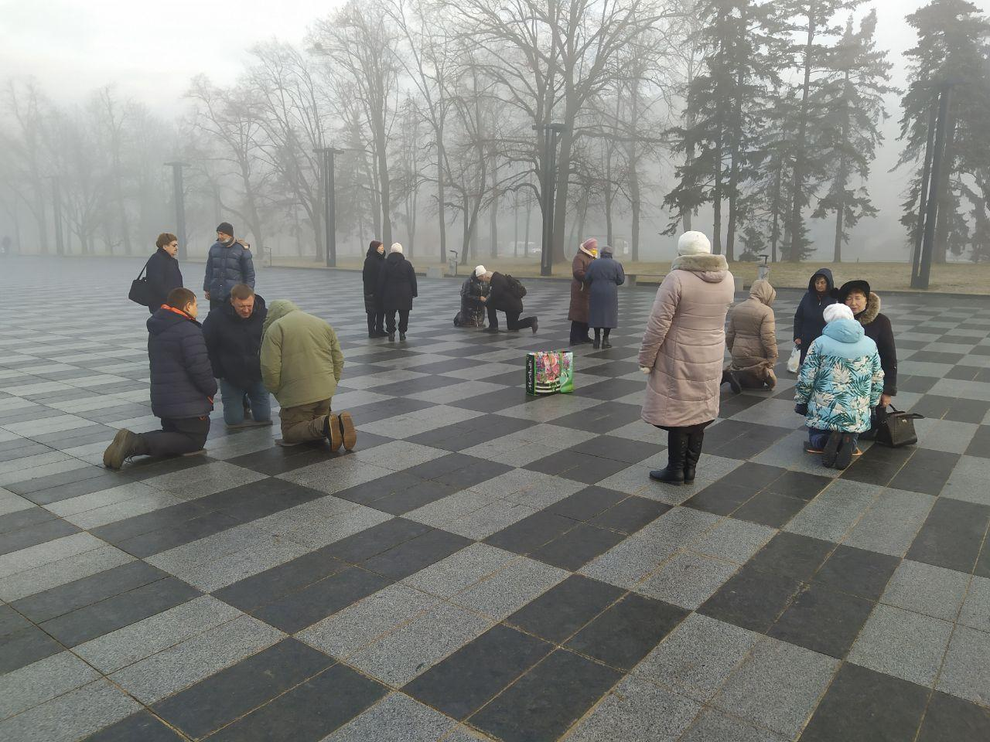
Christians gather in Kharkiv's central square to pray on February 24, 2022, shortly after the war began. Since this picture was taken, Ukraine’s second-largest city has been devastated by bombing and people have taken to hiding in underground metro stations.
The local pastor who held these prayer meetings said, ‘I ask you, in the name of Jesus Christ – whoever can pray please keep us in your prayers. I believe that common prayer is the most powerful weapon that we can overcome the enemy with today.’

Slide 3
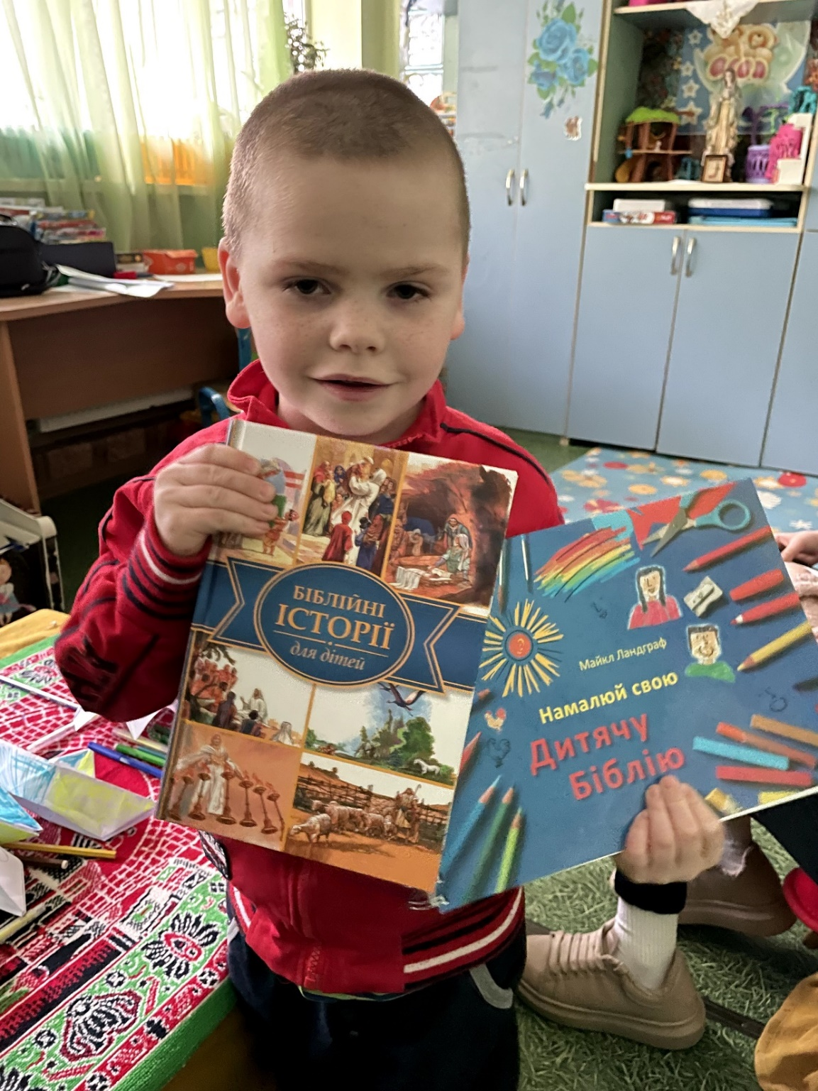
One of many children from an orphanage who were evacuated to the city of Lviv in western Ukraine for their safety. The children all received Bible Society Scriptures. The Bible Society team spent three hours with the children – dancing, singing, playing and reading the Bible.

Slide 4
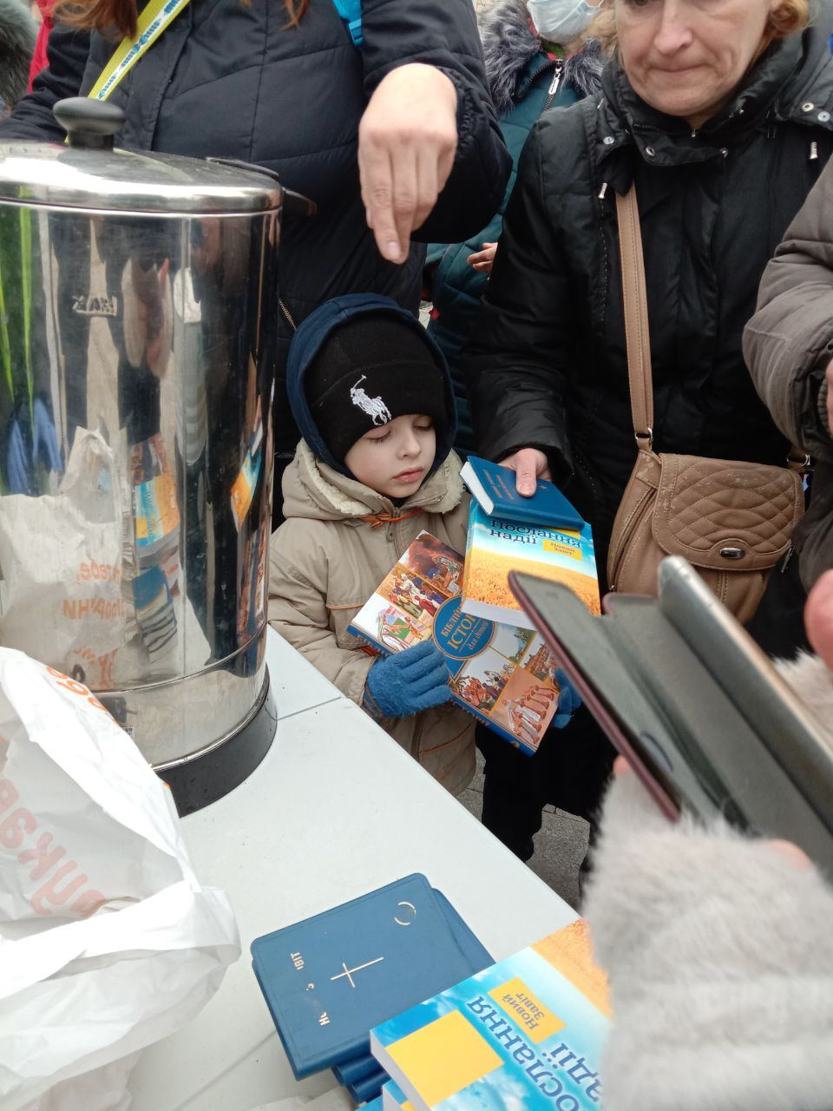
A woman and a child collect a Bible and Scripture books from a Bible Society distribution point in Kyiv.

Slide 5
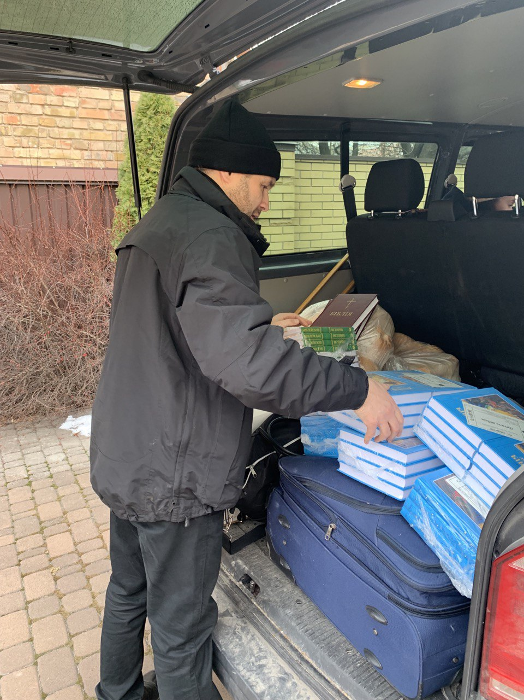
Ukrainian Bible Society Deputy General Secretary Anatoliy Raychynets packs a van with Scriptures for distribution in Kyiv. The teams delivering Scriptures have been given the nickname ‘Angels of Kyiv’ as they work non-stop to bring physical and spiritual food to people stranded in bomb shelters, hospitals, orphanages and elderly people’s homes. People are scared and depressed and these acts of kindness make a powerful impact on their hearts.

Slide 6
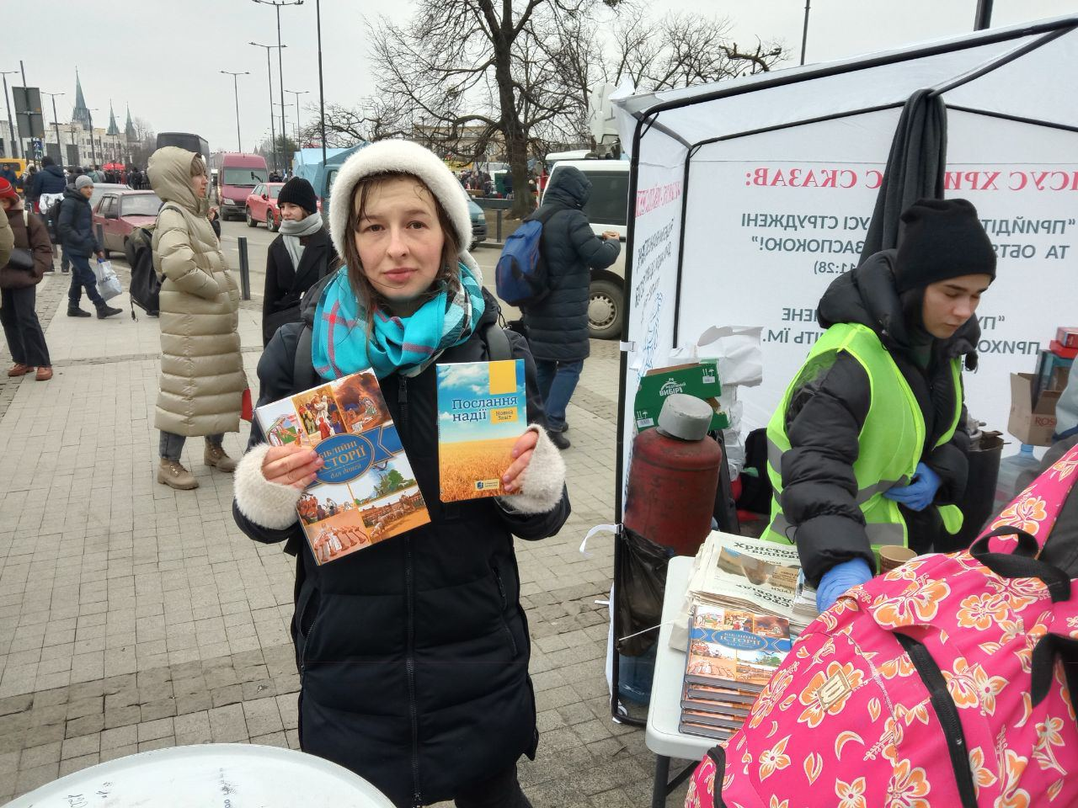
A Bible Society worker holds up Scriptures at a pop-up stall set up in the street in Kyiv to distribute Scriptures to people looking for hope.

Slide 7
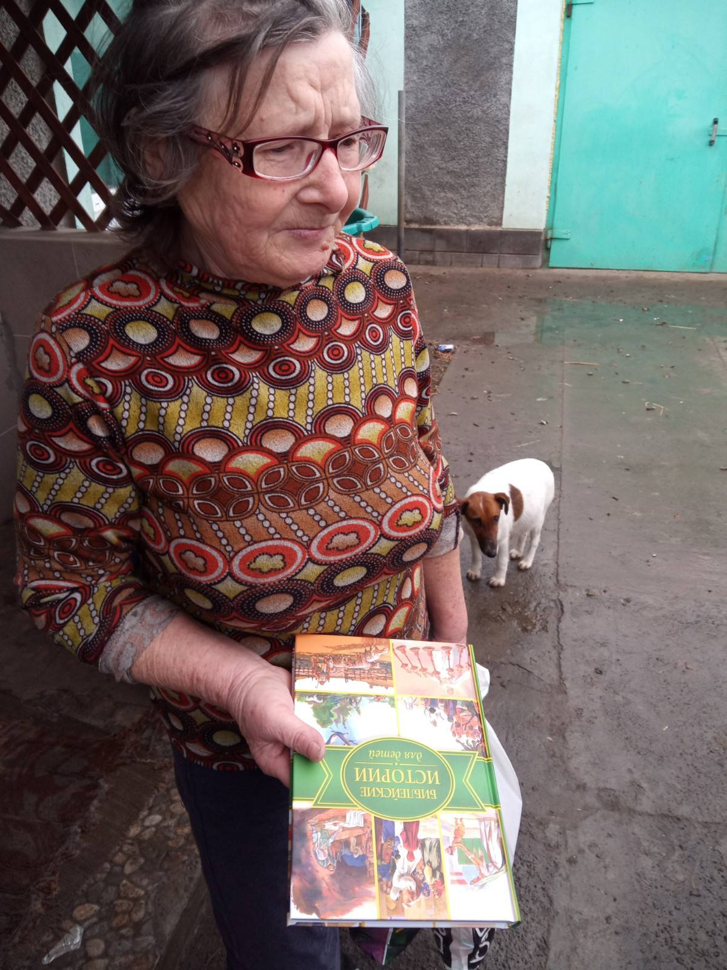
A woman receives a Bible from a Bible Society team. A team member said, ‘Adults and children are very thankful for the care that local churches are showing and they gladly receive Scriptures.’

Slide 8
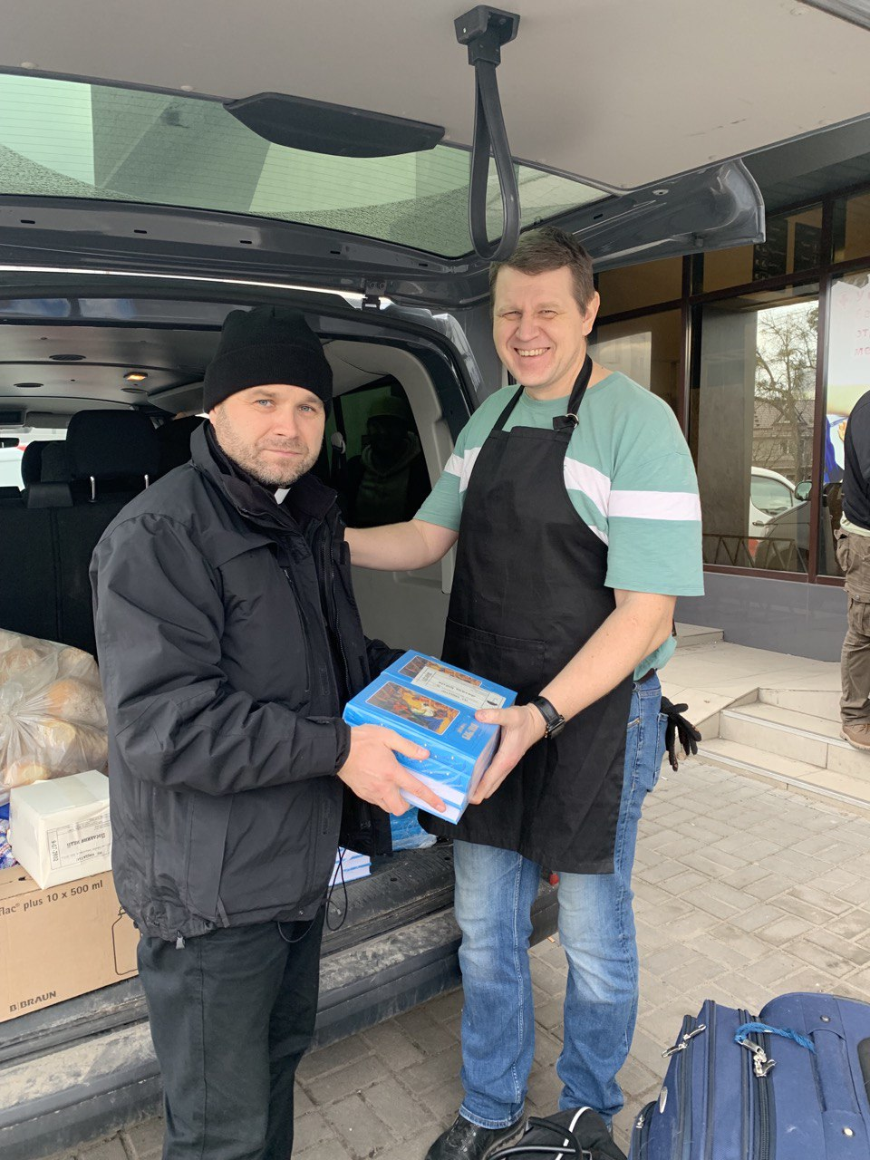
Anatoliy, the Ukrainian Bible Society deputy leader, hands over Bibles to a delivery team from a local church. The Bibles will be distributed to people sheltering from the bombing in Kyiv.

Slide 9
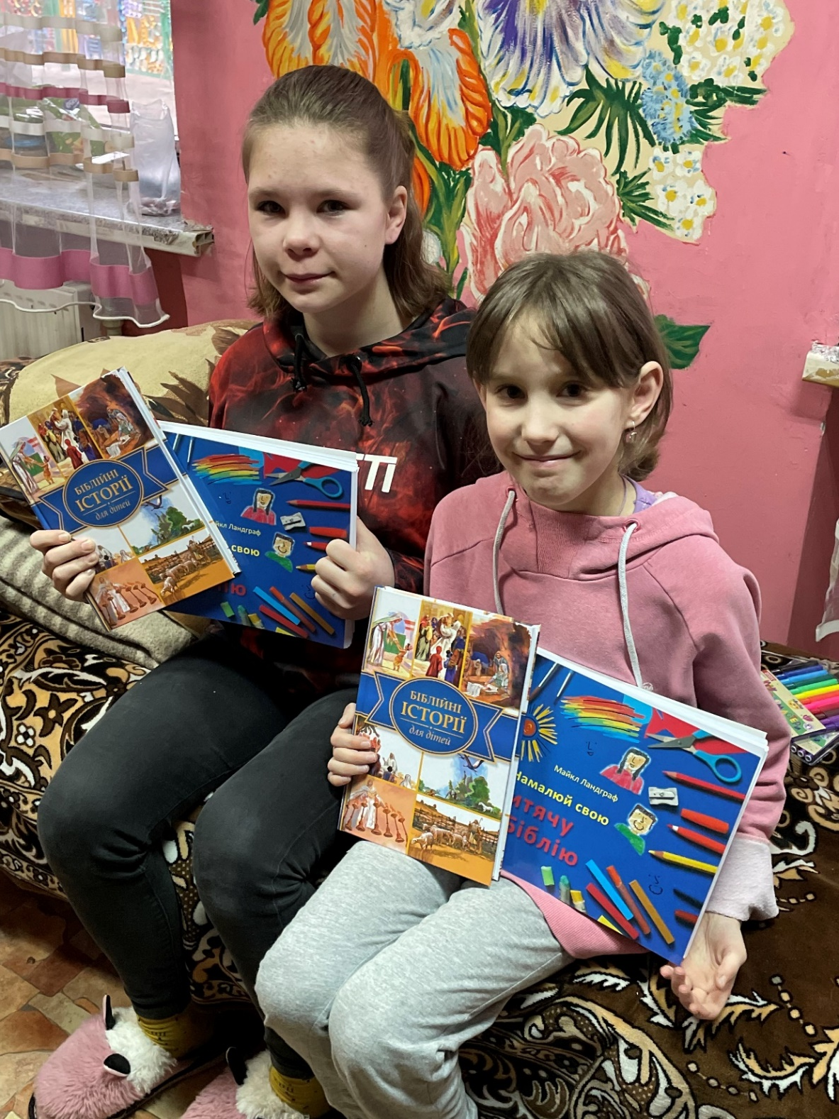
Two more girls, also from the orphanage, who were evacuated to Lviv. As hundreds of thousands of people arrive in Lviv, the Bible Society is working with the churches there to provide them with Scriptures and humanitarian aid.

Slide 10
We’re working with our partners in England and Wales
to provide Bibles to refugees and opportunities for trauma healing.

Slide 11
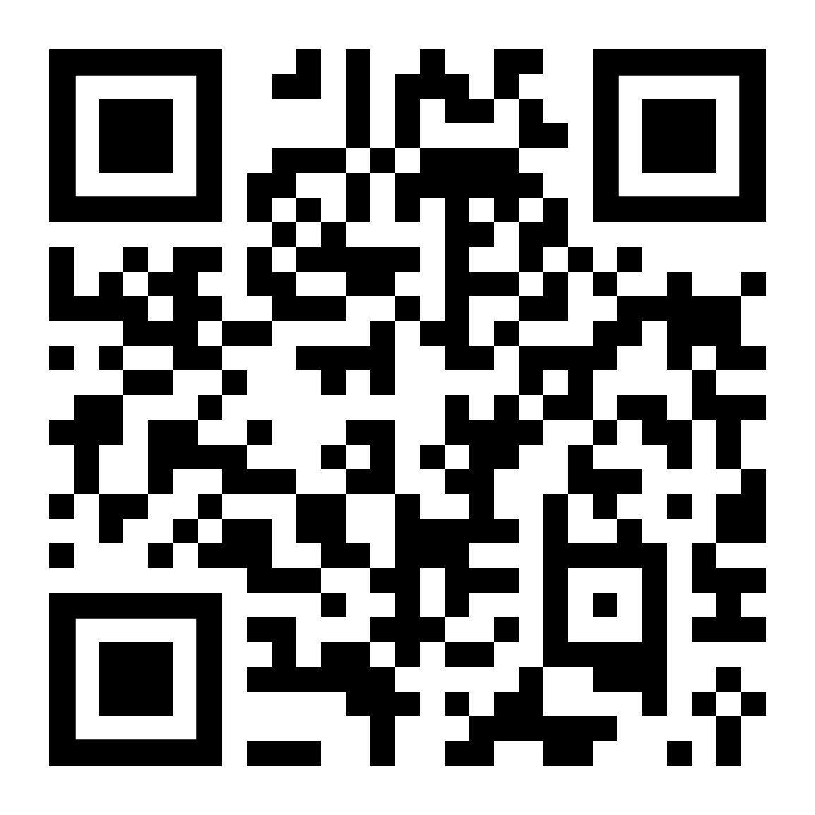
You can provide Ukrainian people with hope through the Bible today by going to
biblesociety.org.uk/ukrainechurch
Images are for use in church presentations. For any wider usage please contact Bible Society.

