Slide 1
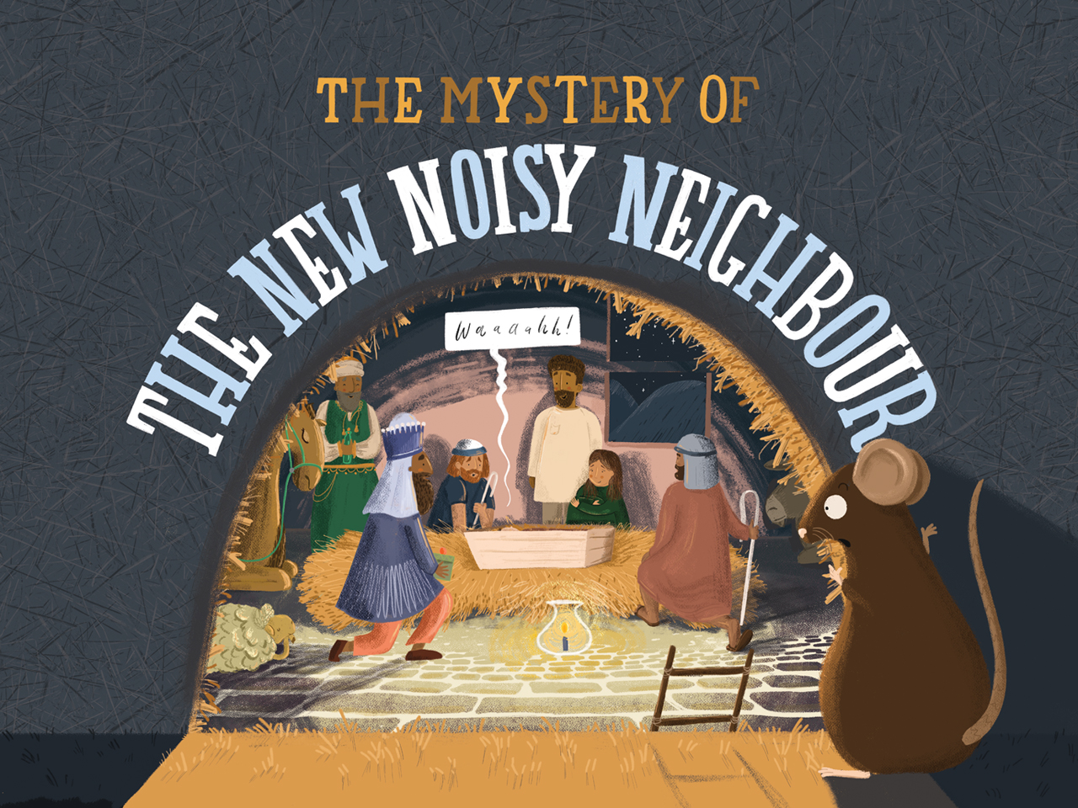

Slide 2
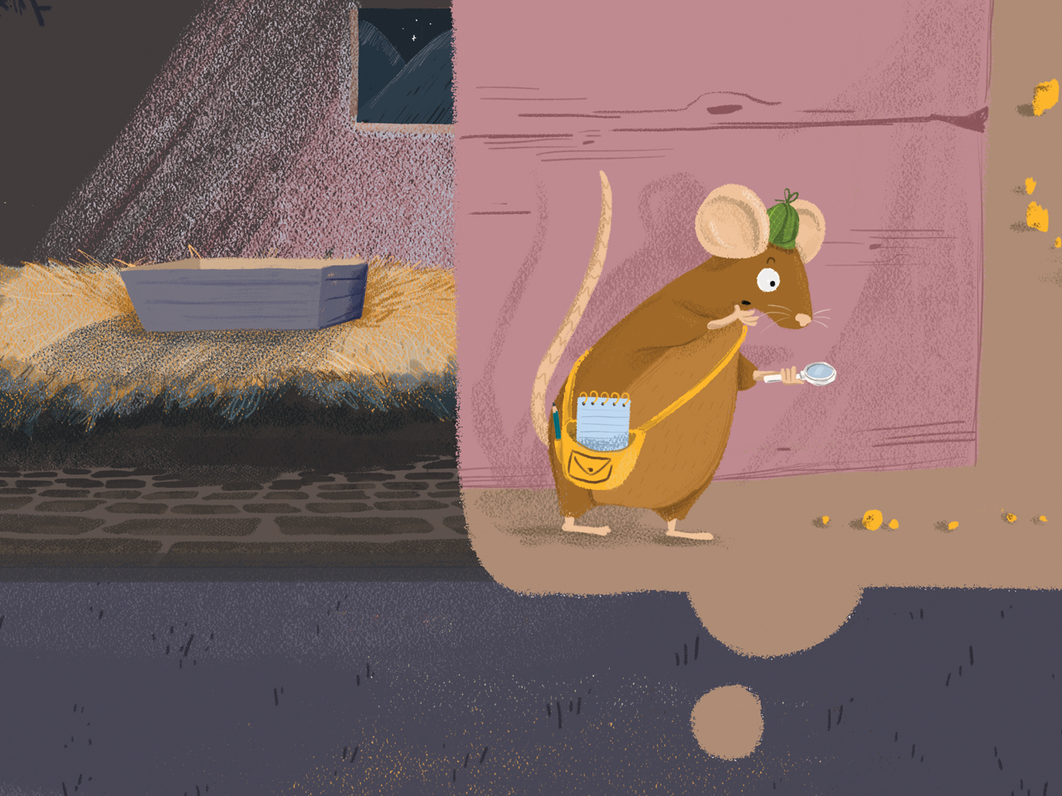

Slide 3

NOISE/NOISY Put your hands over your ears
ONES WITH STICKS Lift imaginary Shepherd’s crook and tap it on the floor
ONES WITH GIFTS Mime holding a gift and giving it to someone
RESCUE/RESCUER Strike a superhero/victory pose
KING Mime placing a crown on your head
EMMANUEL Point heavenwards then place hand over heart

Slide 4
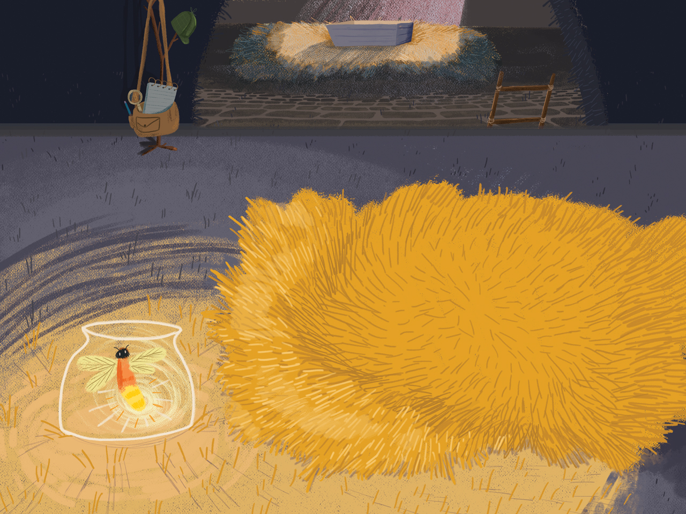

Slide 5
Waaaaaaaaah!

Slide 6
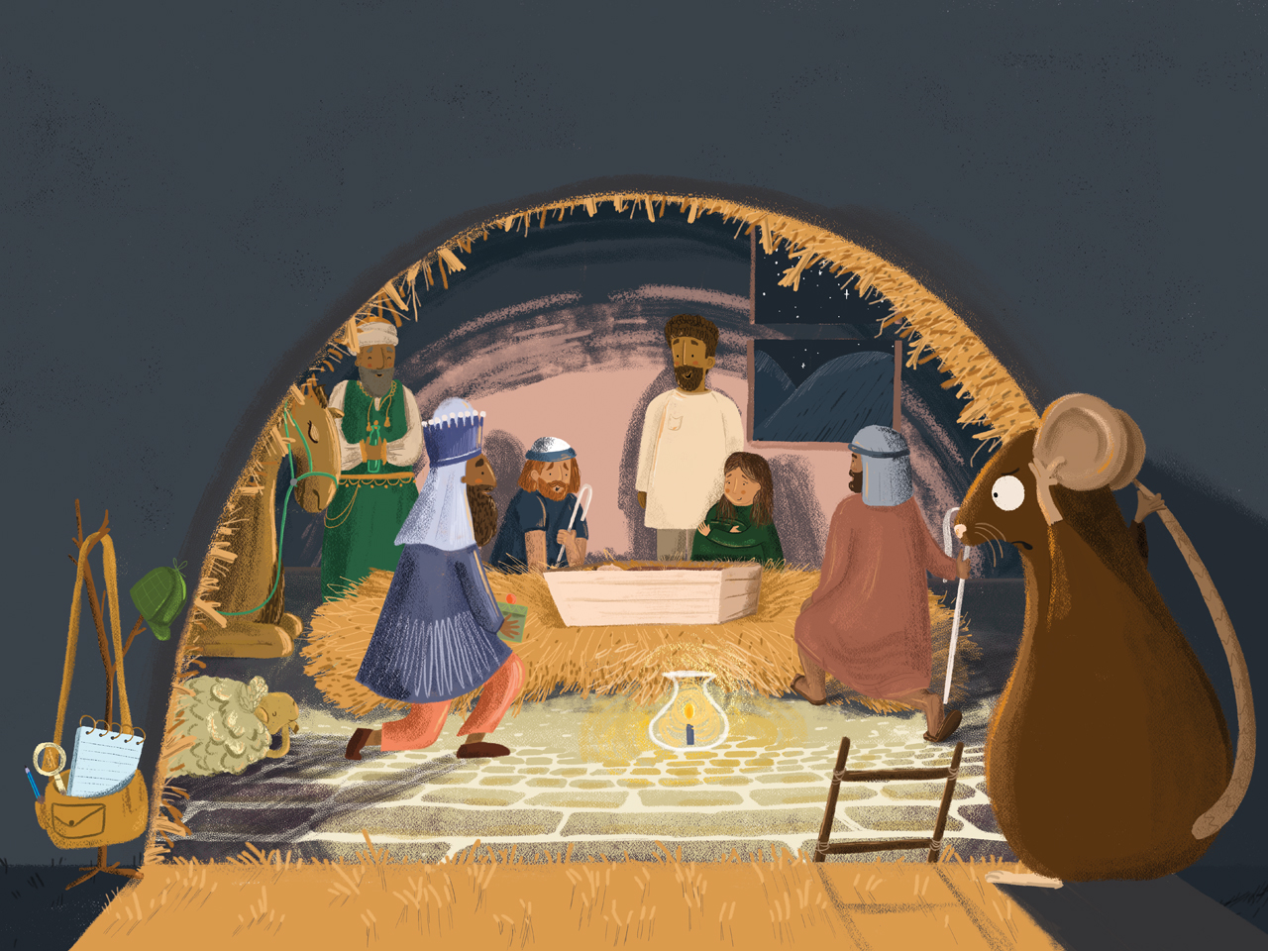

Slide 7
EE-AW!

Slide 8
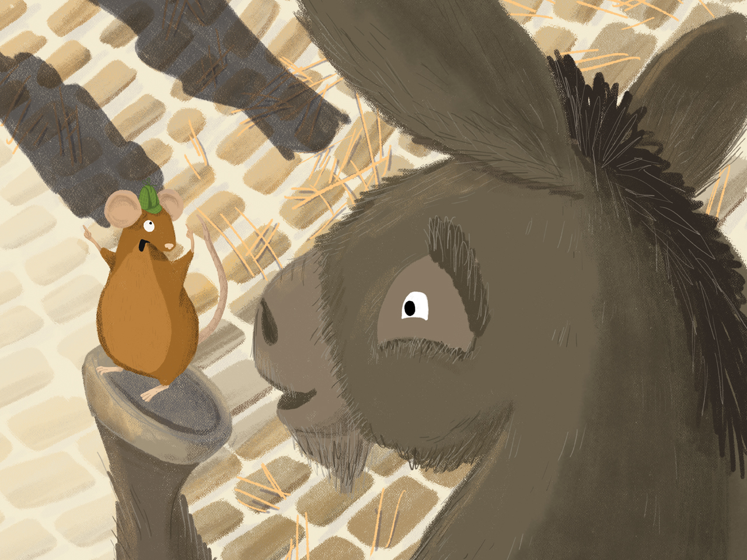

Slide 9
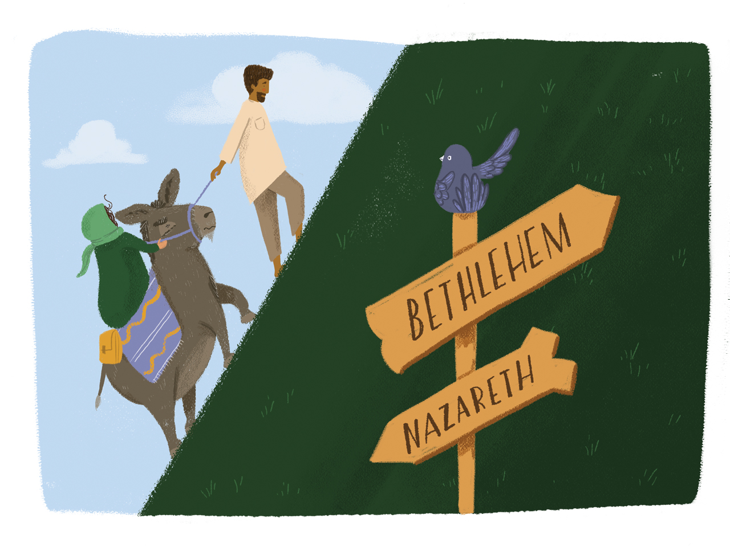

Slide 10
Clip-clop, clip-clop, clip-clop!

Slide 11
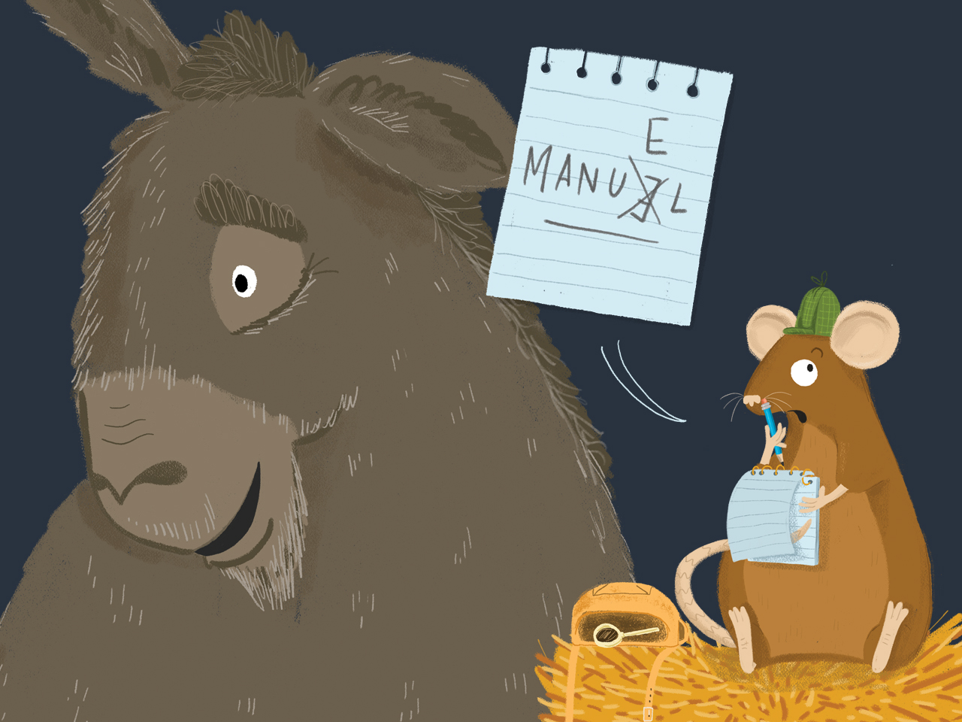

Slide 12
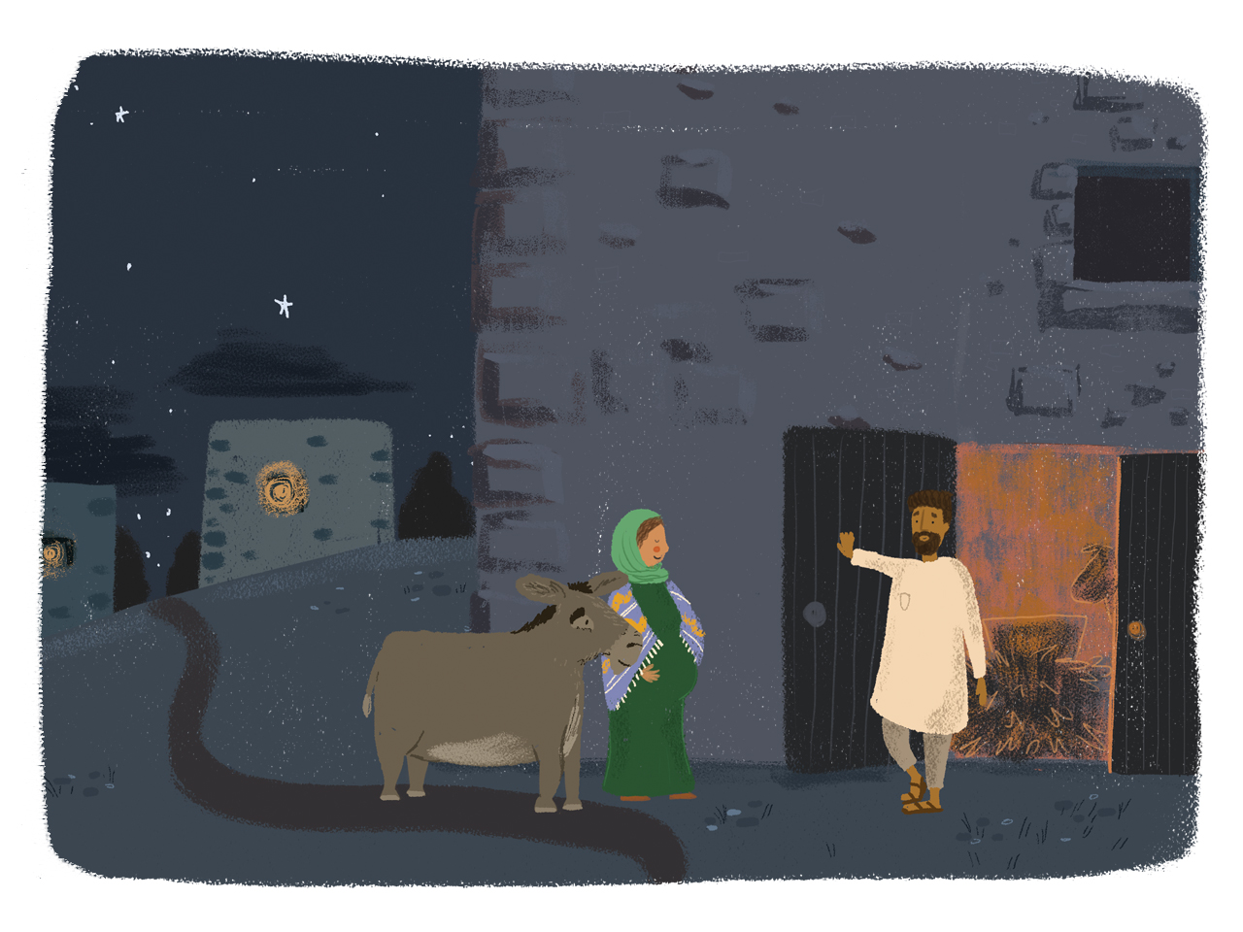

Slide 13
Clip-clop, clip-clop, clip-clop!

Slide 14
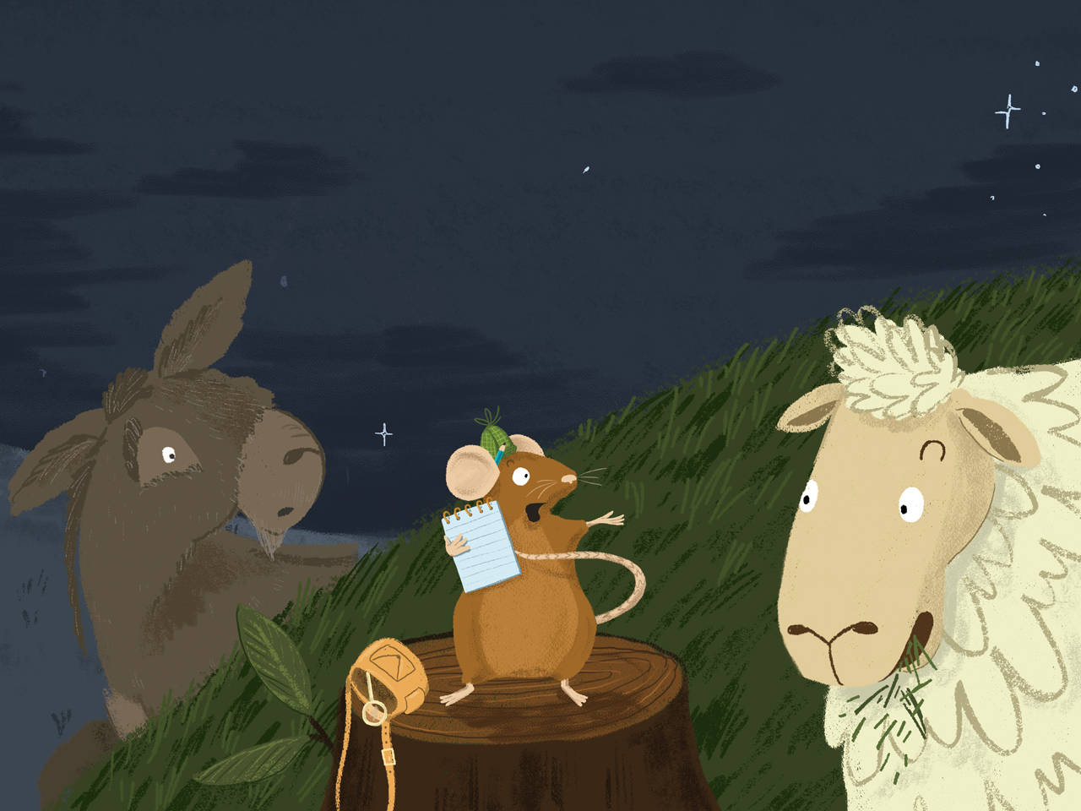

Slide 15
Baaaaaaaaaaaa

Slide 16
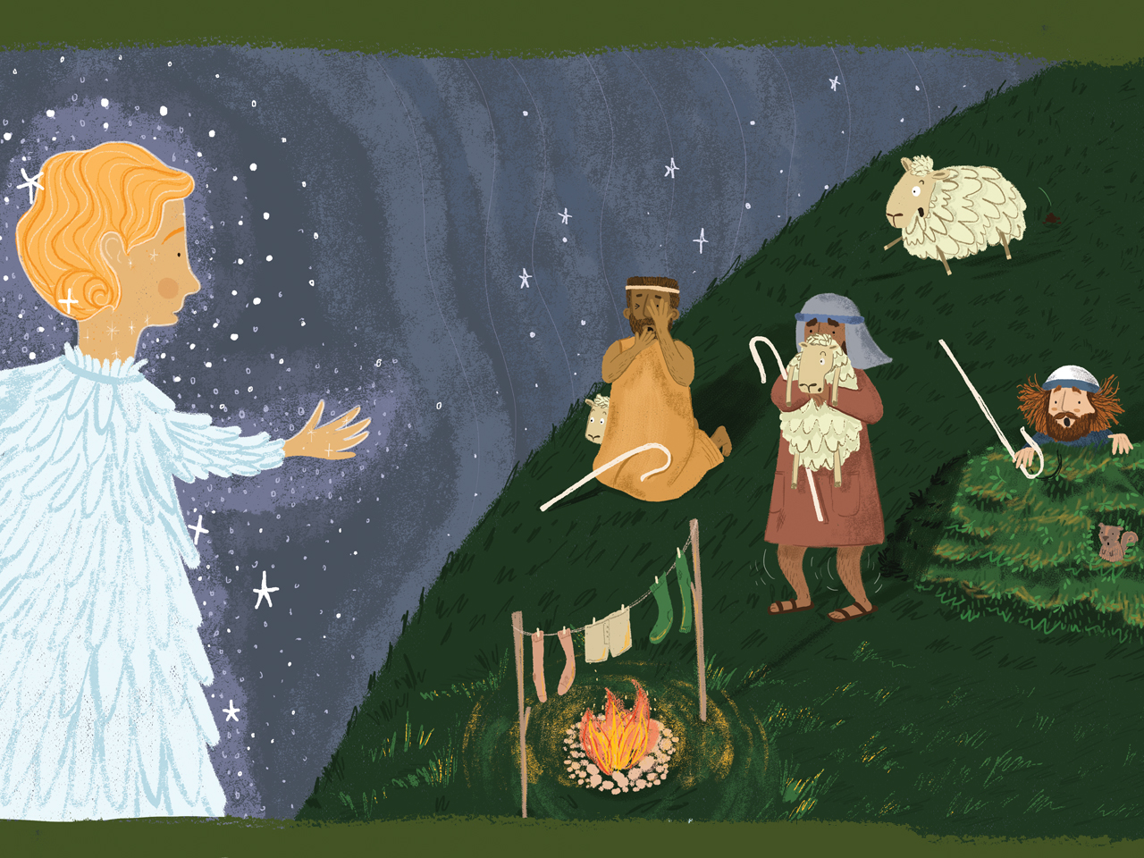

Slide 17
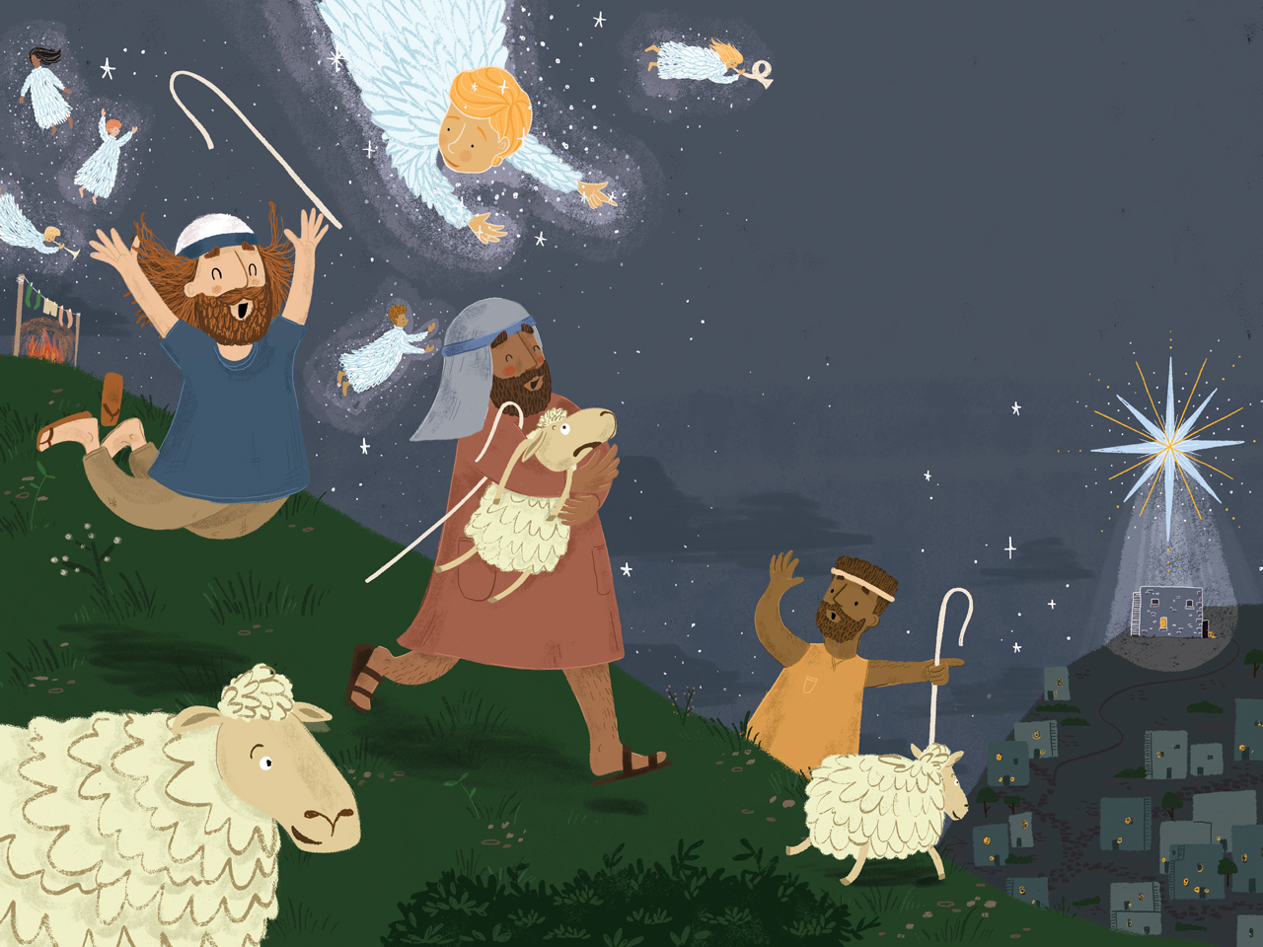

Slide 18
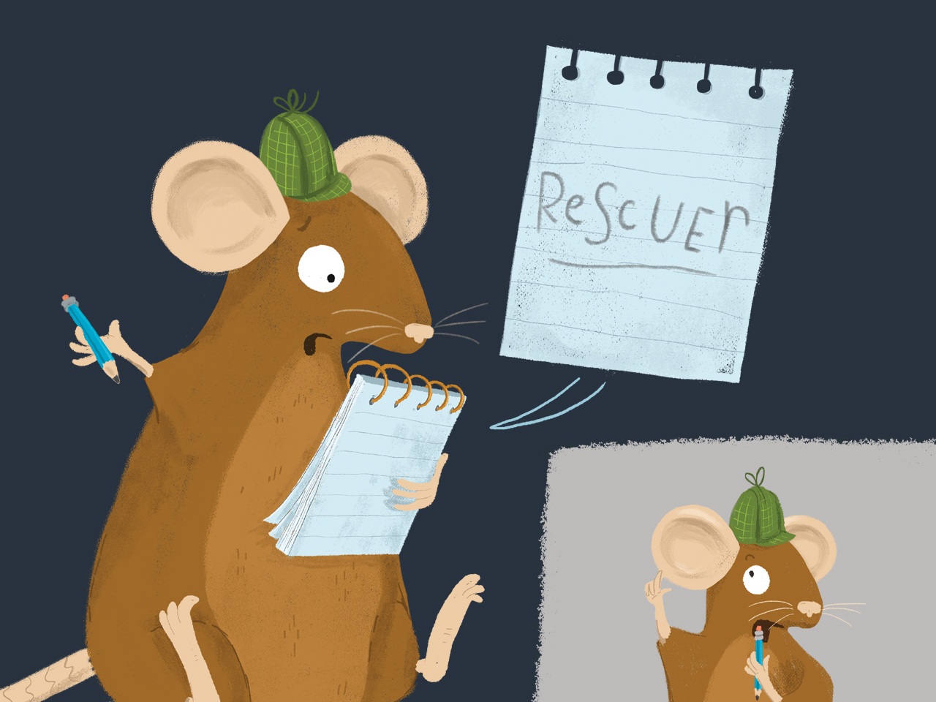

Slide 19
Clip-clop, clip-clop, clip-clop!

Slide 20
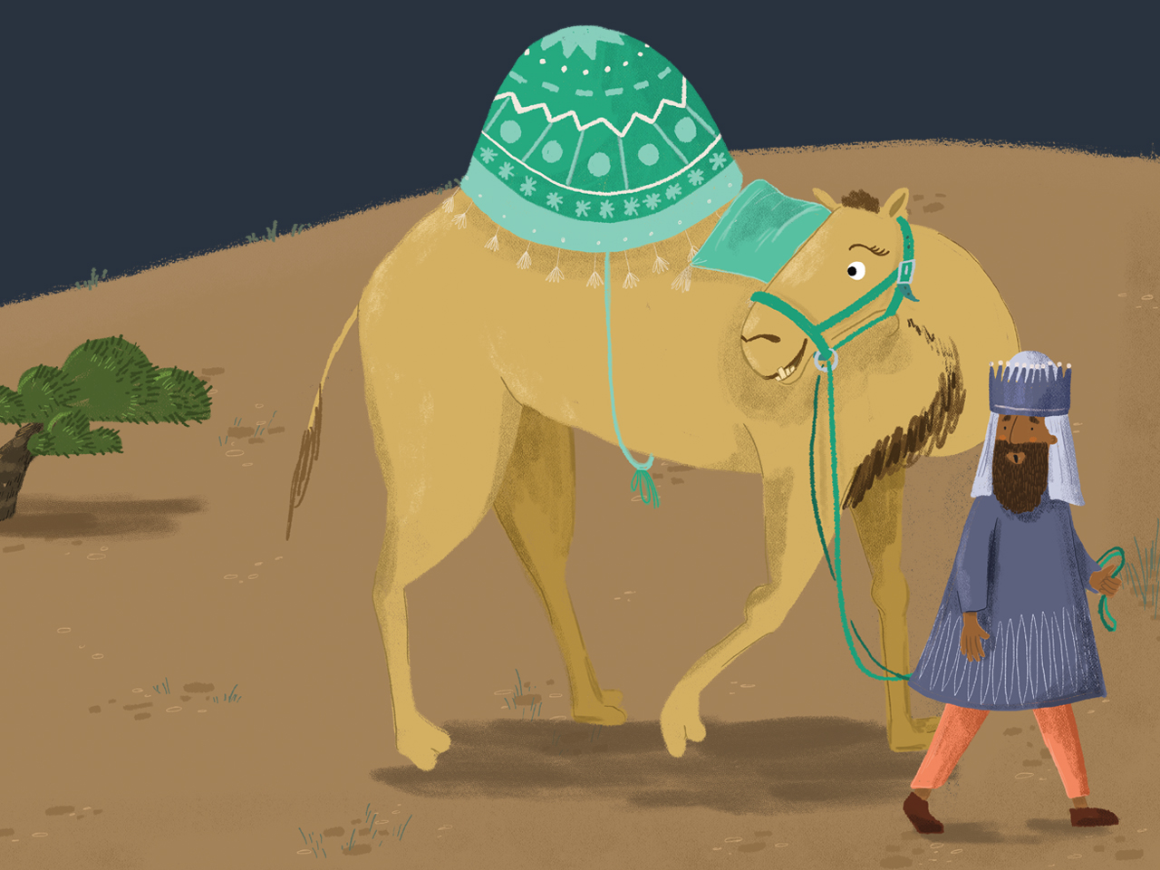

Slide 21
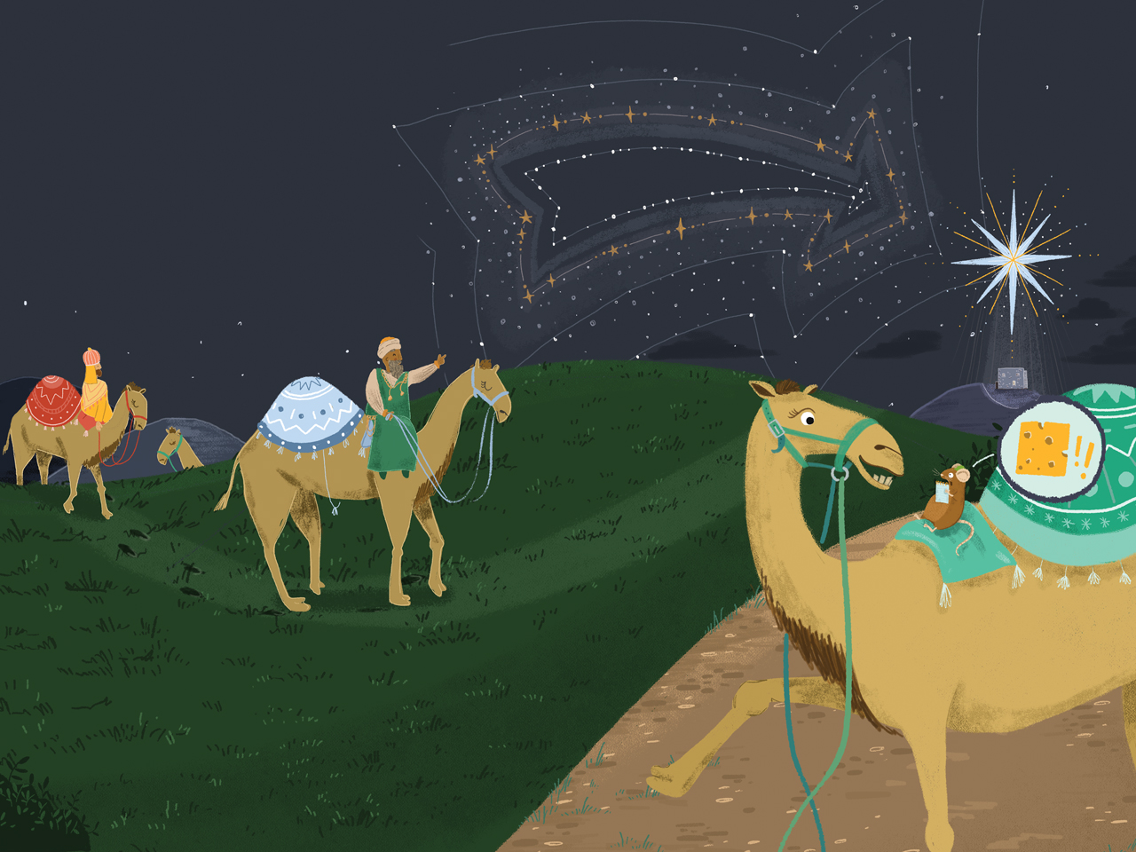

Slide 22
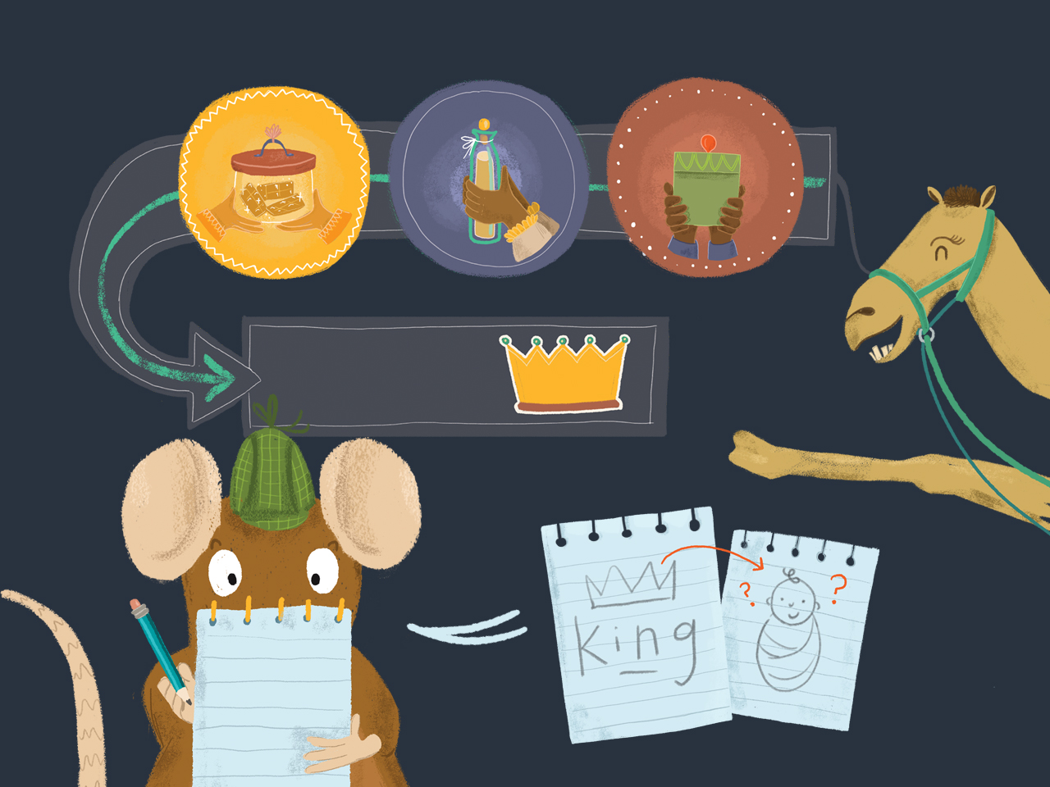

Slide 23
Boooooooooooo

Slide 24
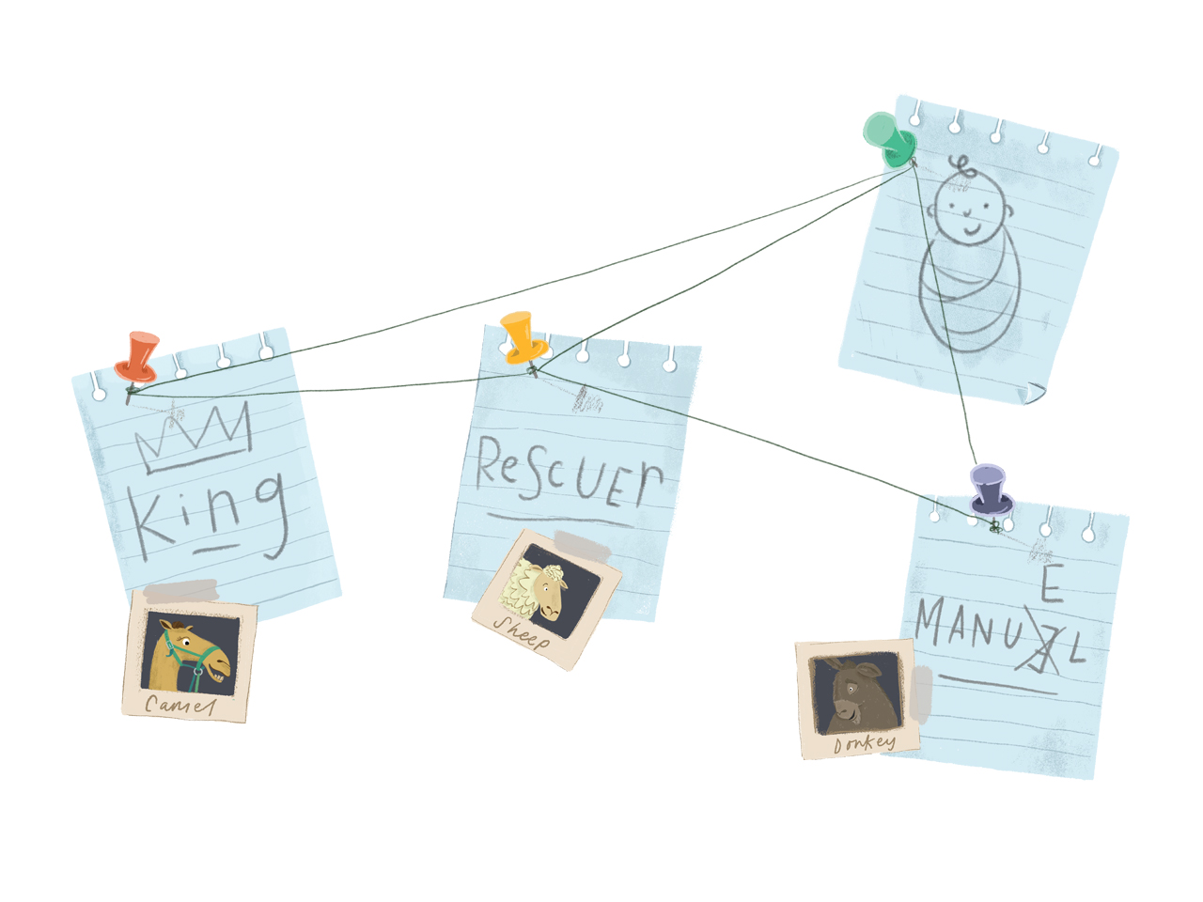

Slide 25
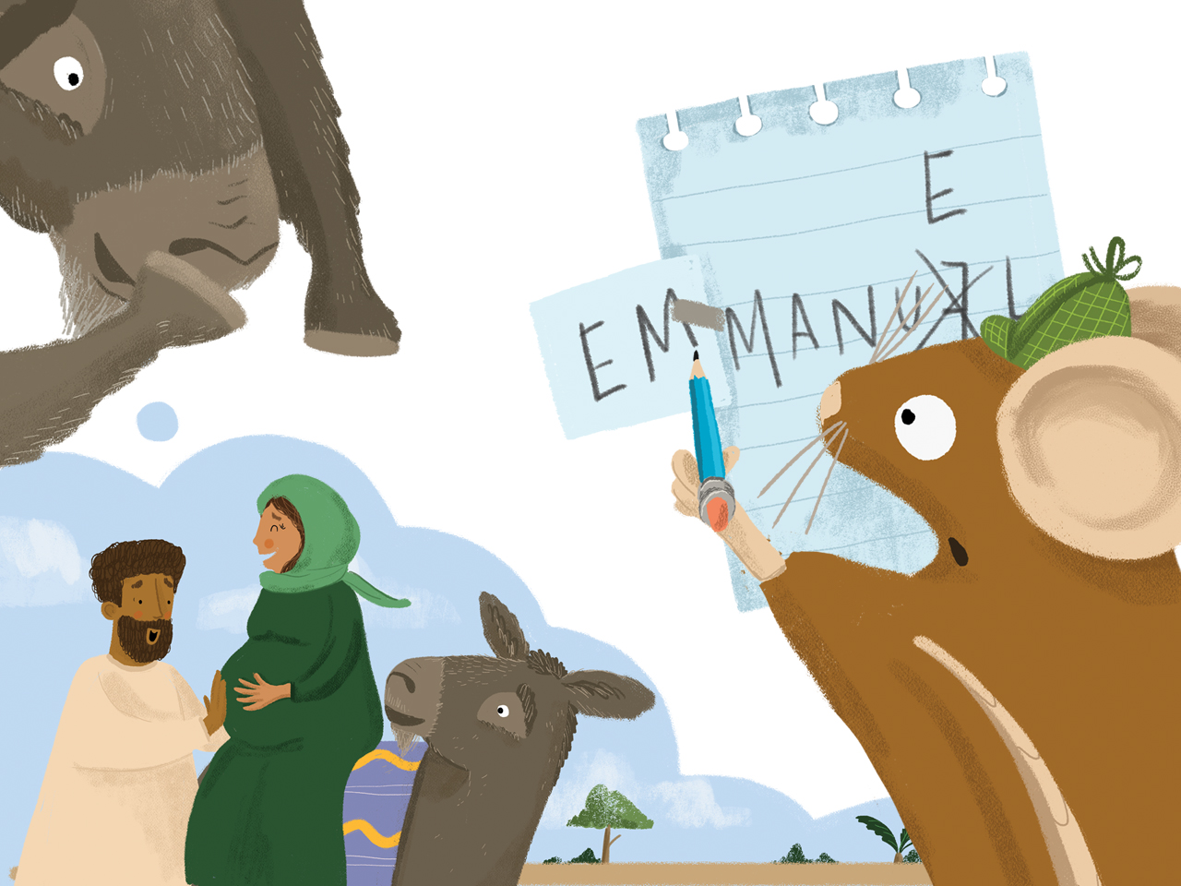

Slide 26
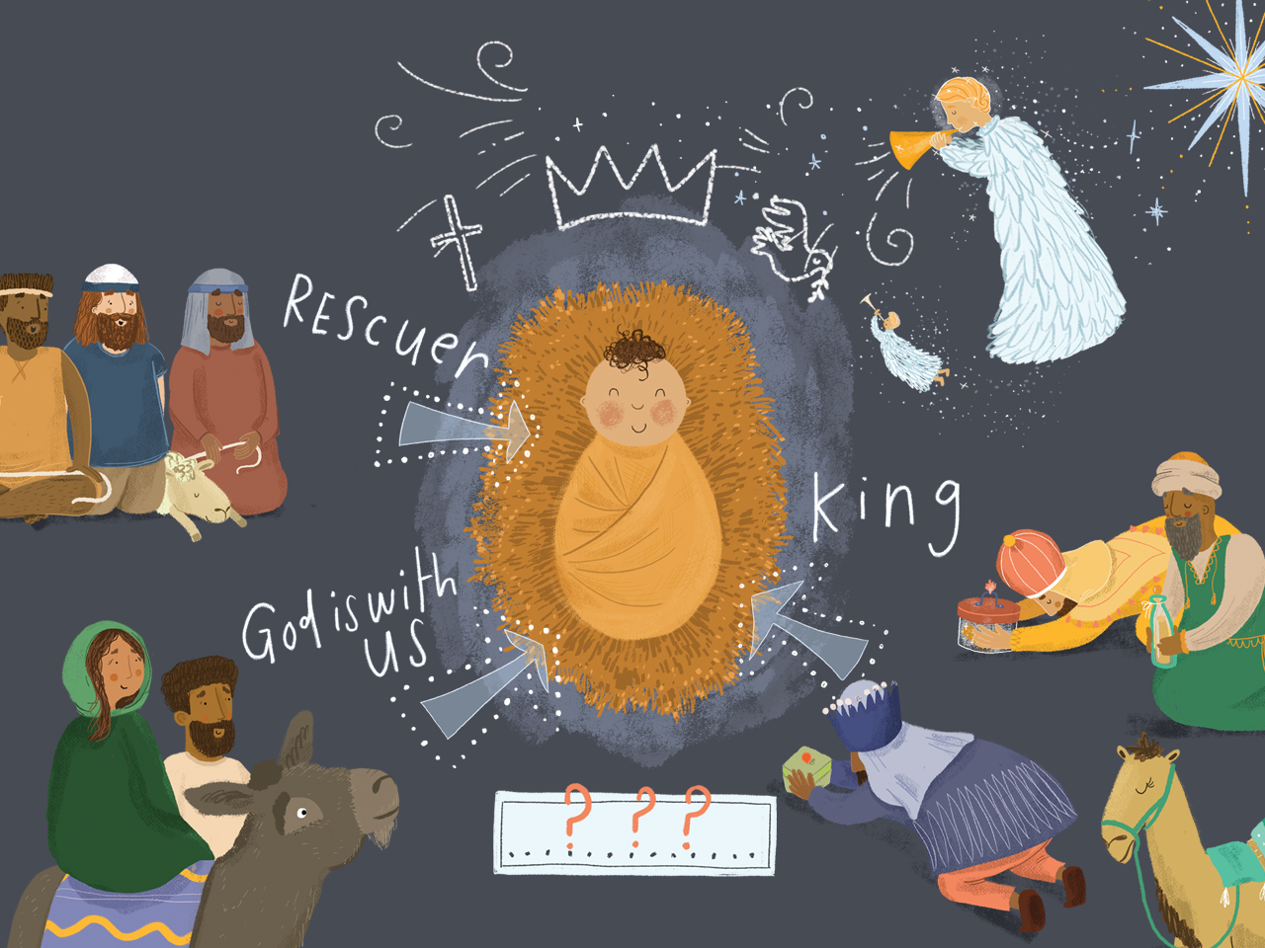

Slide 27
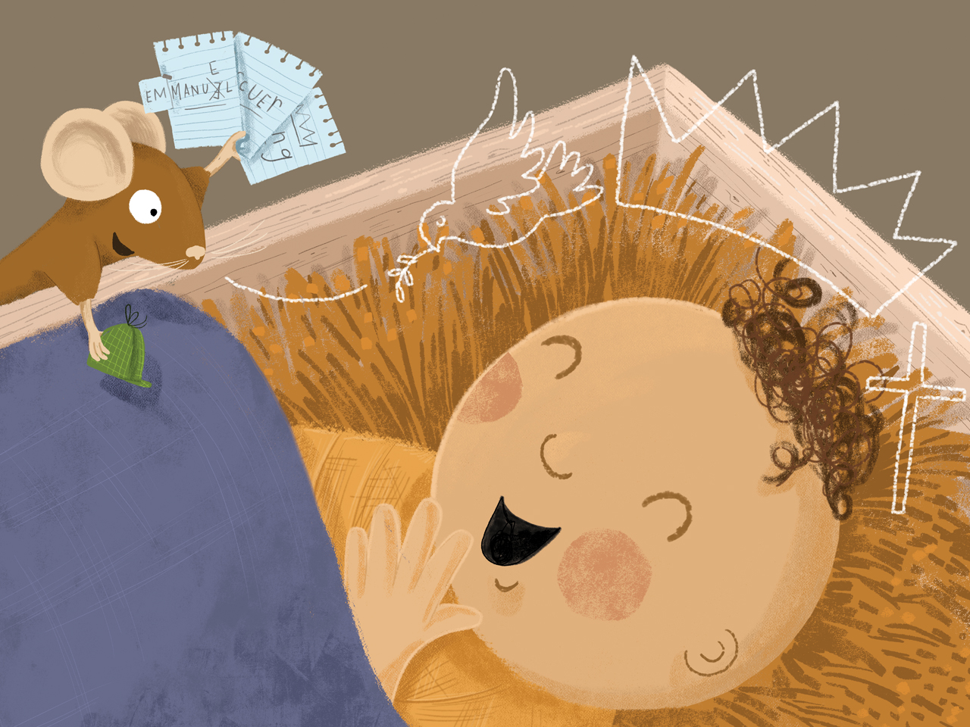

Slide 28
