Slide 1


Slide 2
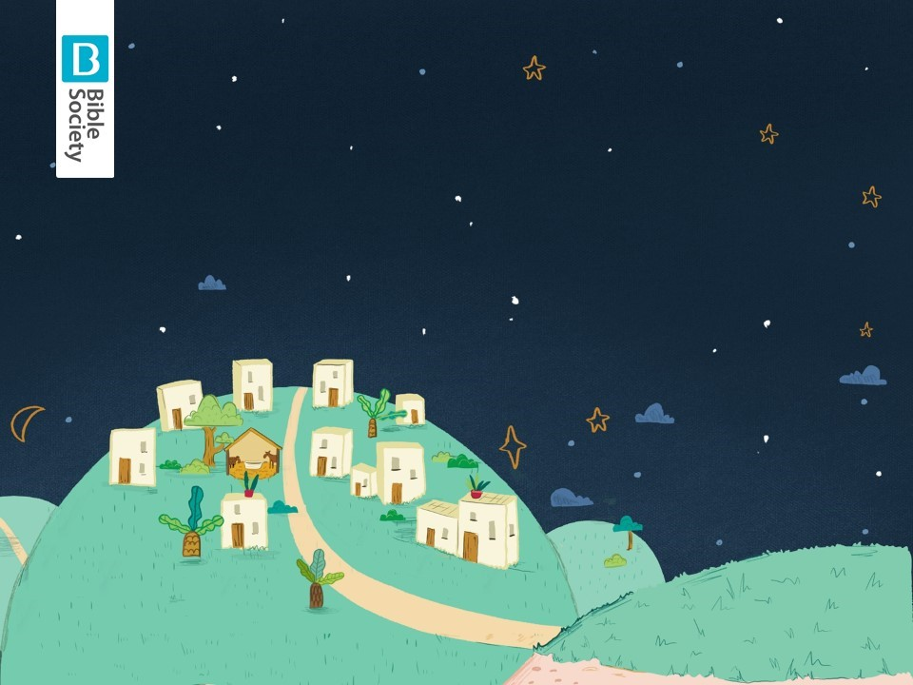

Slide 3
Journey: Marching action and huffing and puffing
Big one: Stretch your arms out as far as you can
Uh-oh/oh-no: Gasp and put your hand over your mouth
Can’t: Wag your finger and shake your head

Slide 4
Are you ready for your journey?

Slide 5
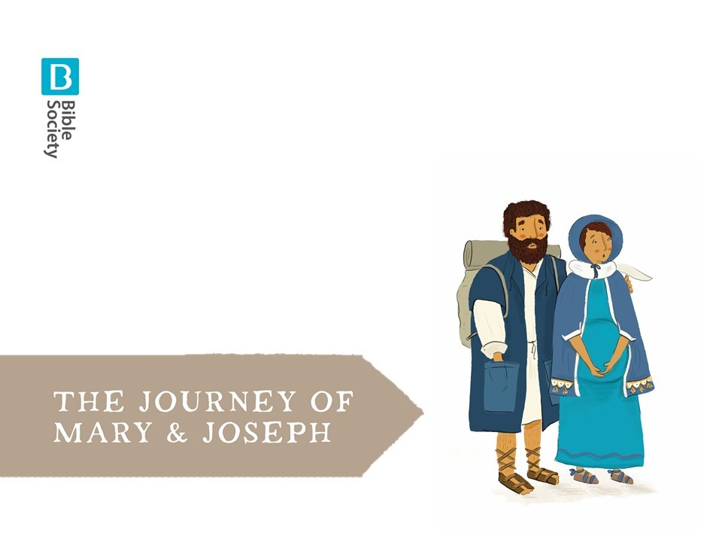

Slide 6

EVERYONE:
We’re going on a journey
It’s going to be a BIG one!

Slide 7
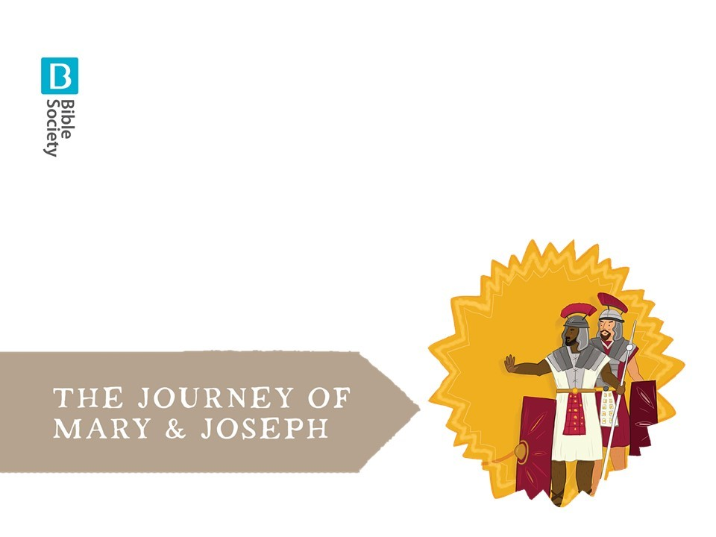

Slide 8
EVERYONE:
We can’t jump over them,
We can’t crawl under them.

Slide 9
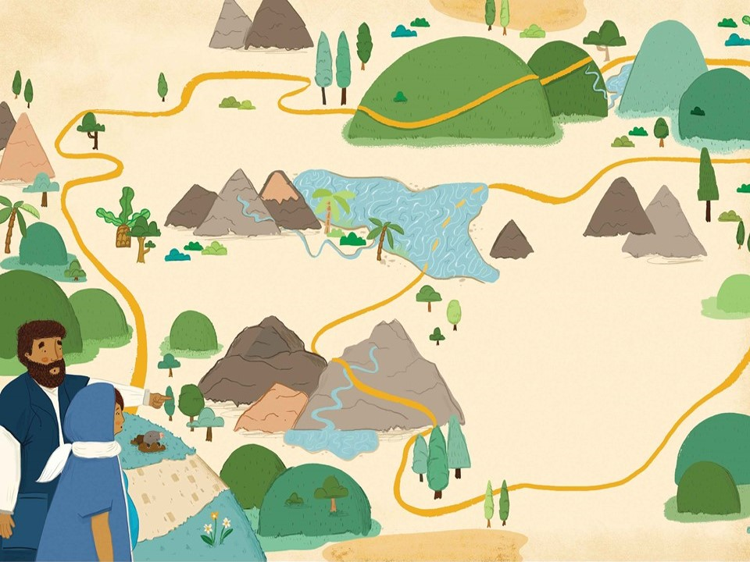

Slide 10
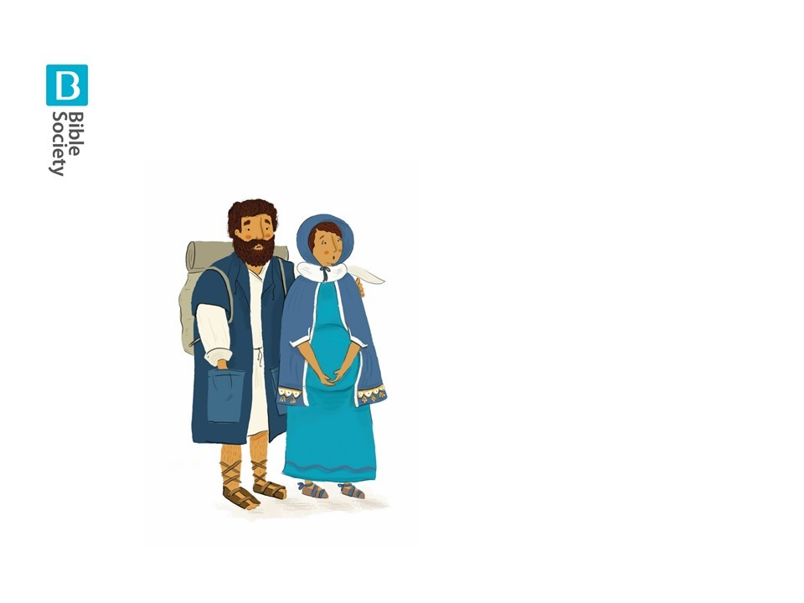

Slide 11
EVERYONE:
We’re going on a journey
It’s going to be a BIG one!

Slide 12
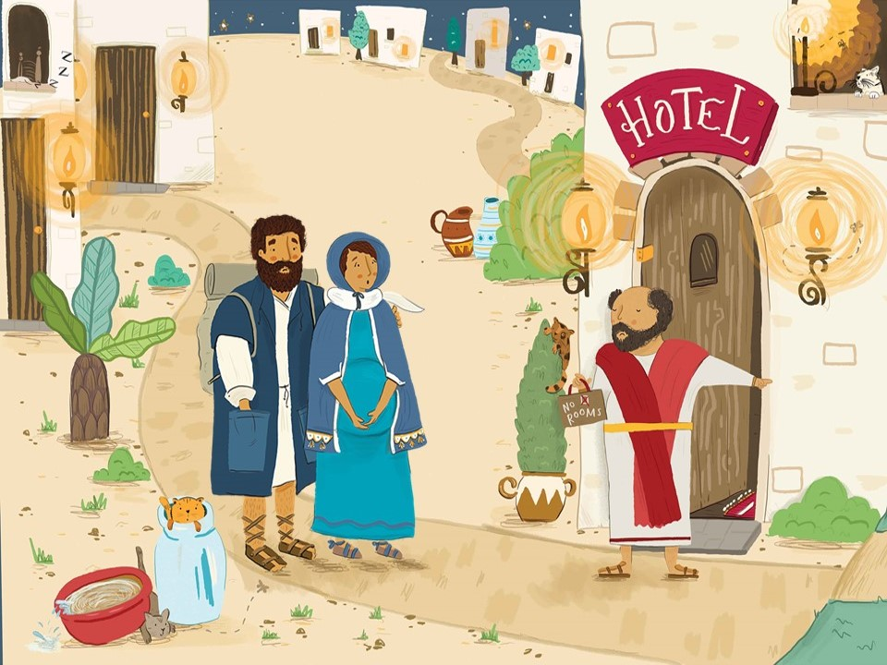

Slide 13
EVERYONE:
We can’t stay in the hotel,
We can’t stay in the spare room!

Slide 14
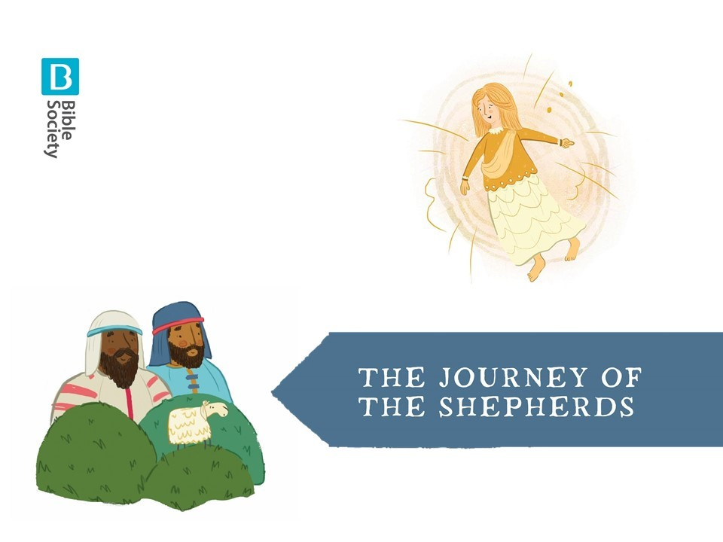

Slide 15
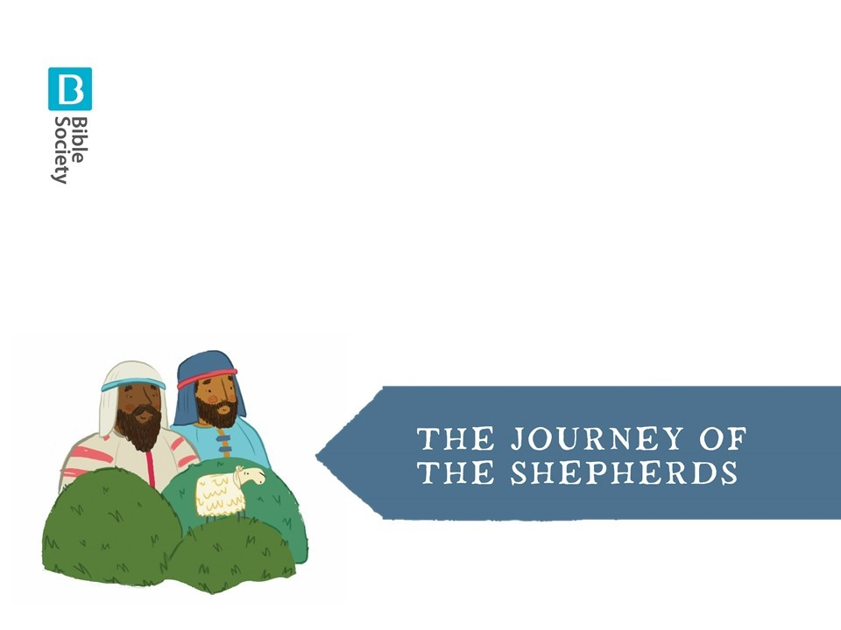
EVERYONE:
We’re going on a journey
It’s going to be a BIG one!

Slide 17
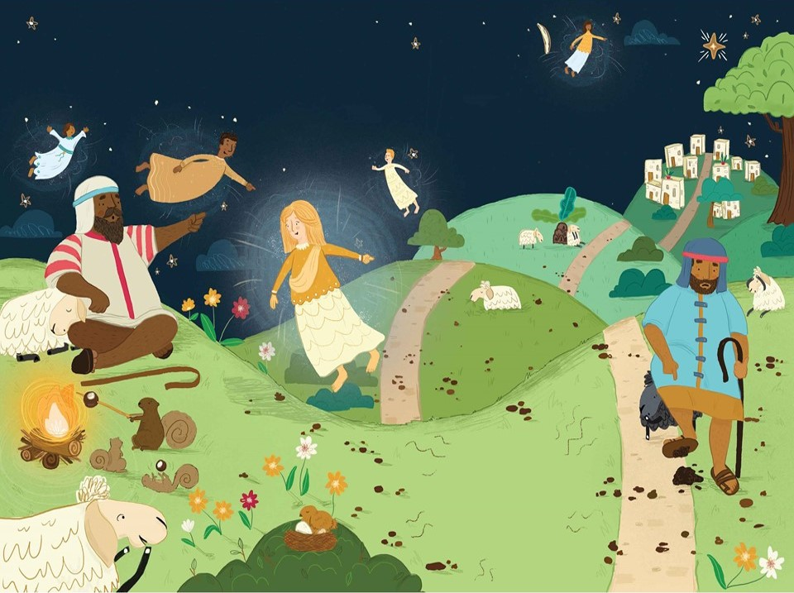

Slide 18
EVERYONE:
We can’t fly over it,
We can’t tip-toe round it!

Slide 19


Slide 20
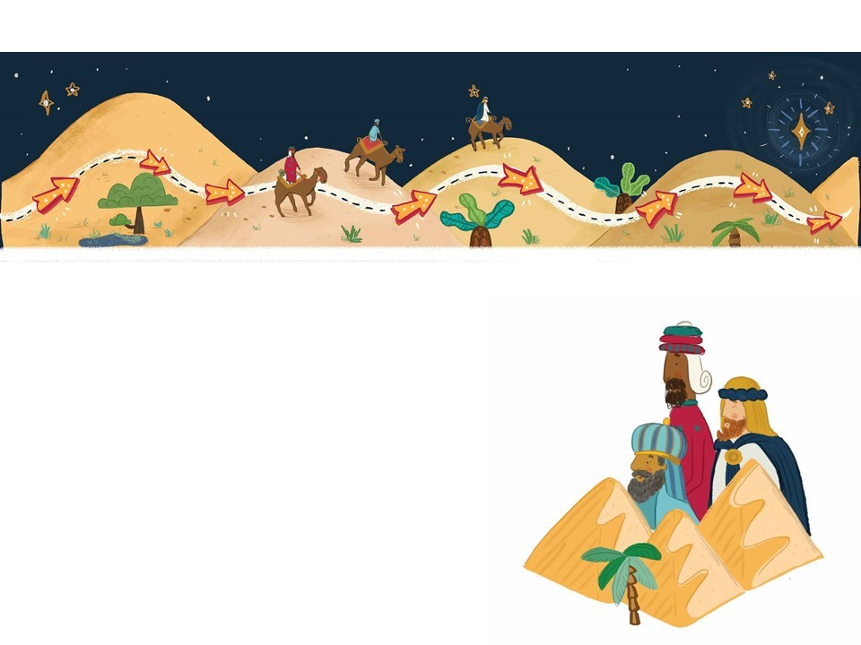
EVERYONE:
We’re going on a journey
It’s going to be a BIG one!

Slide 21
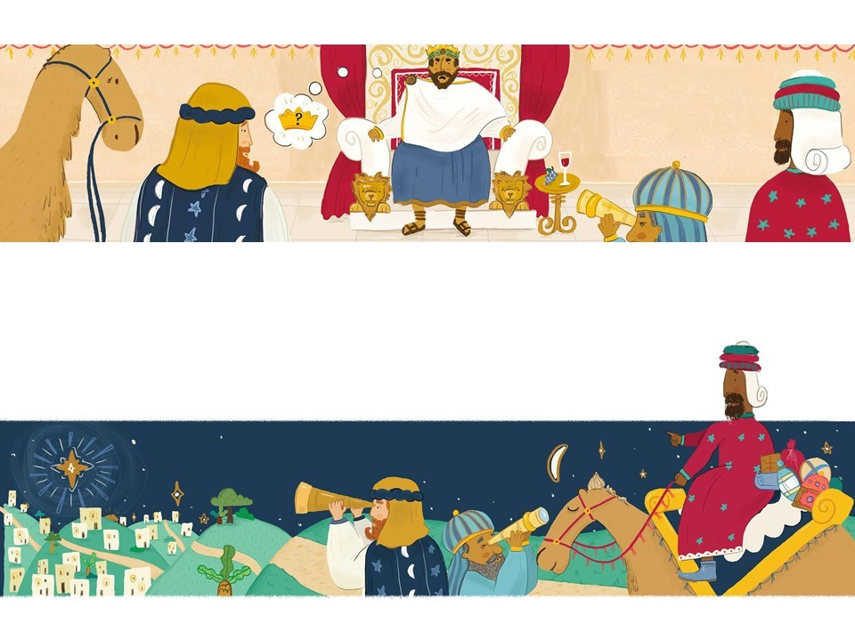

Slide 22
EVERYONE:
We can’t listen to Herod,
We can’t say where Jesus is!

Slide 23
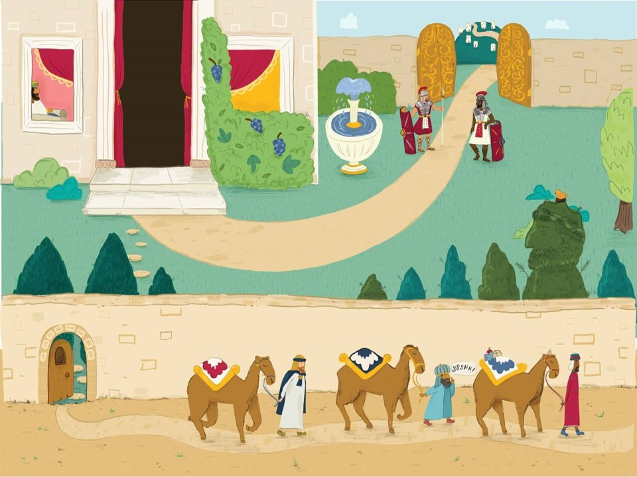

Slide 24
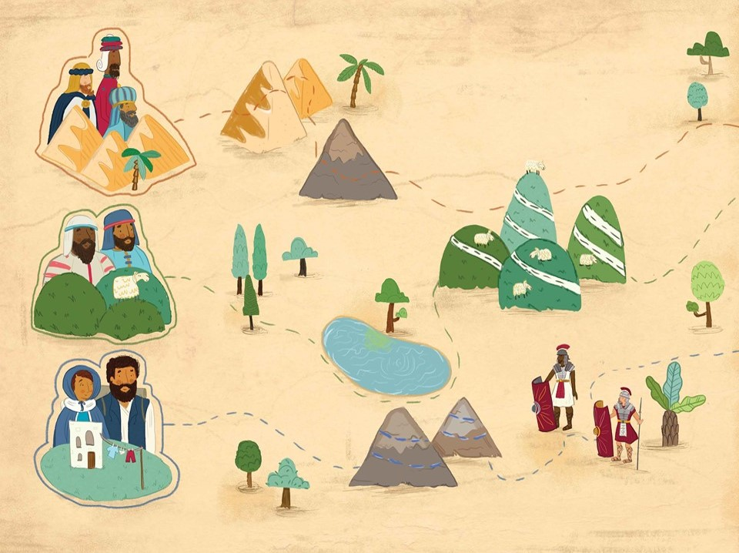

Slide 25
EVERYONE:
We’ve gone on a journey
But we’re glad we did so…

Slide 26
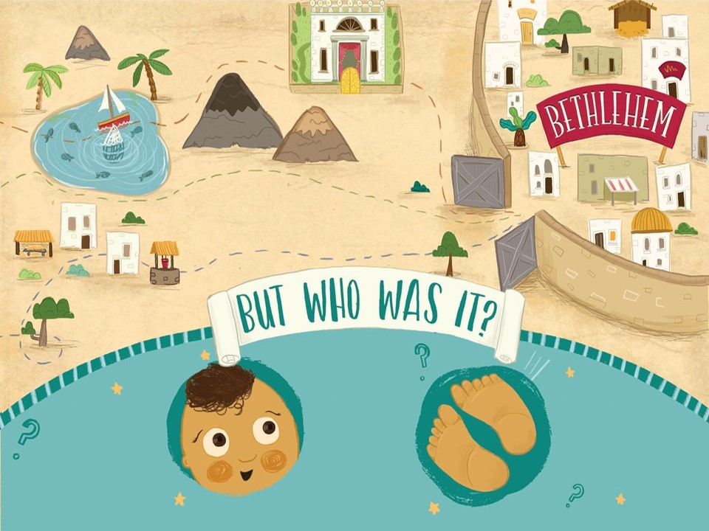

Slide 27
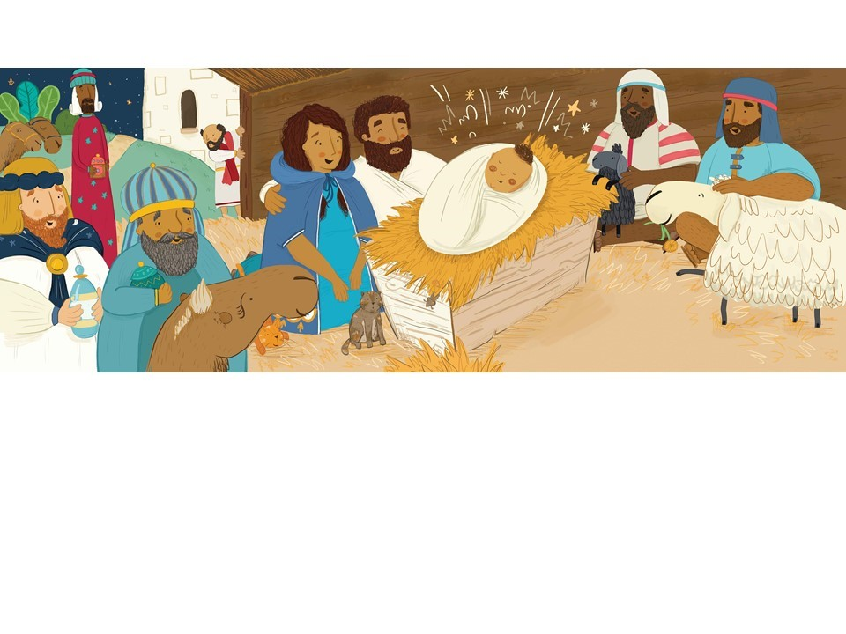
EVERYONE:
Why, it’s JESUS!!!

Slide 28
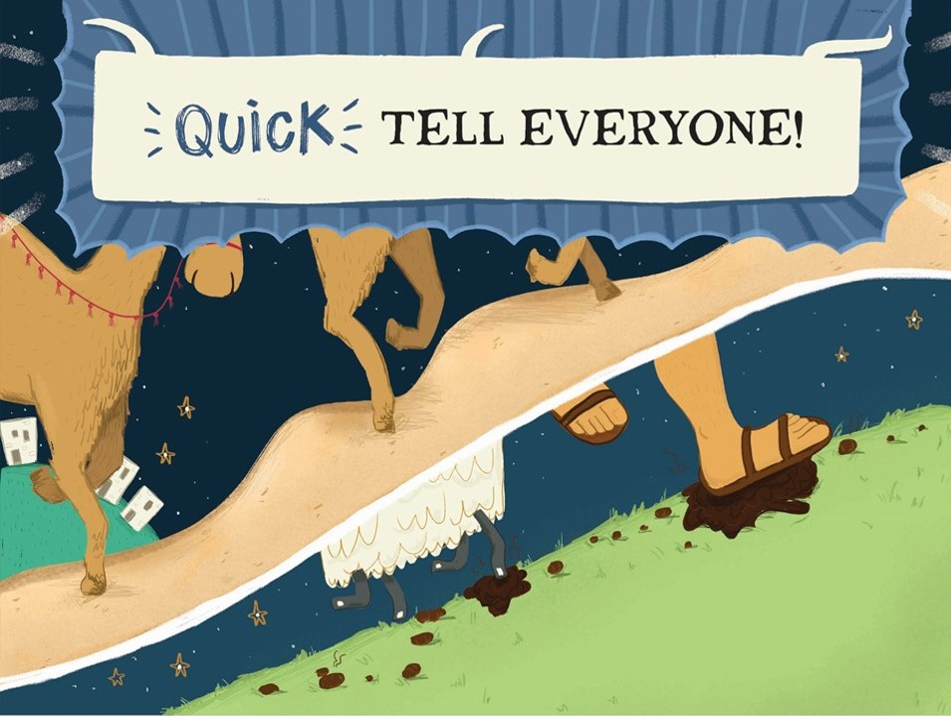

Slide 29
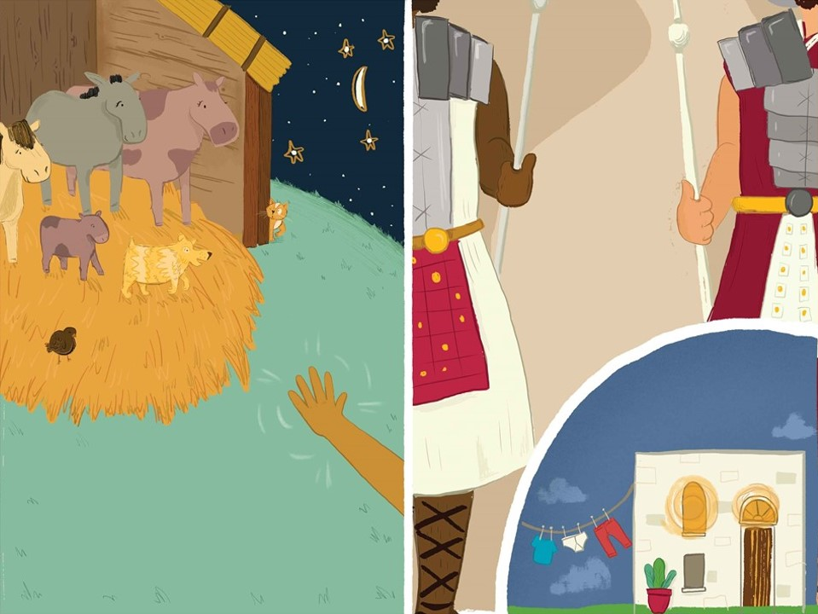

Slide 30
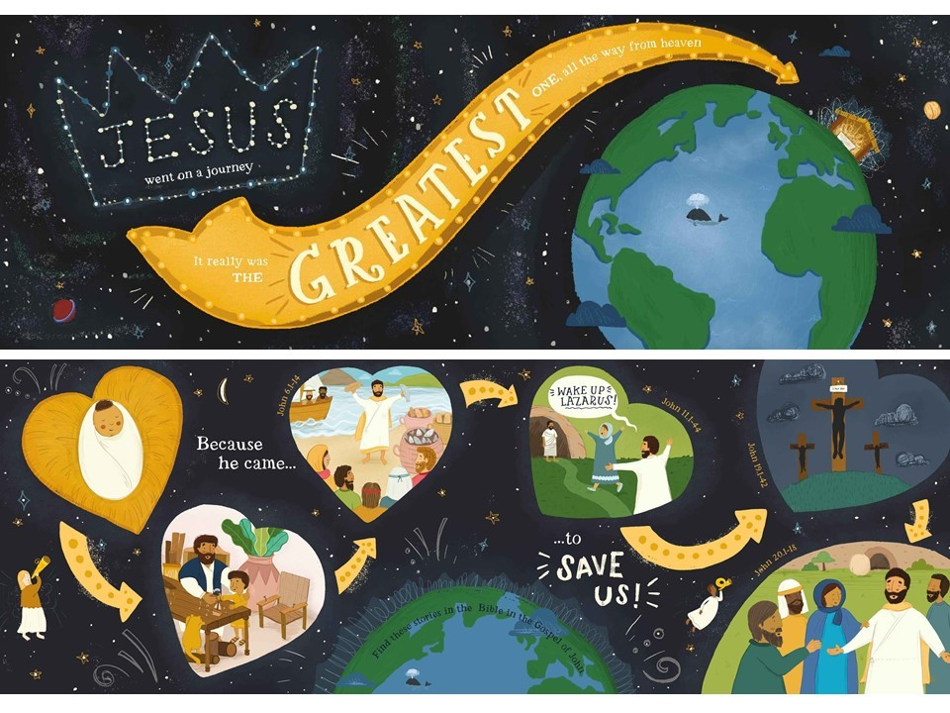

Slide 31
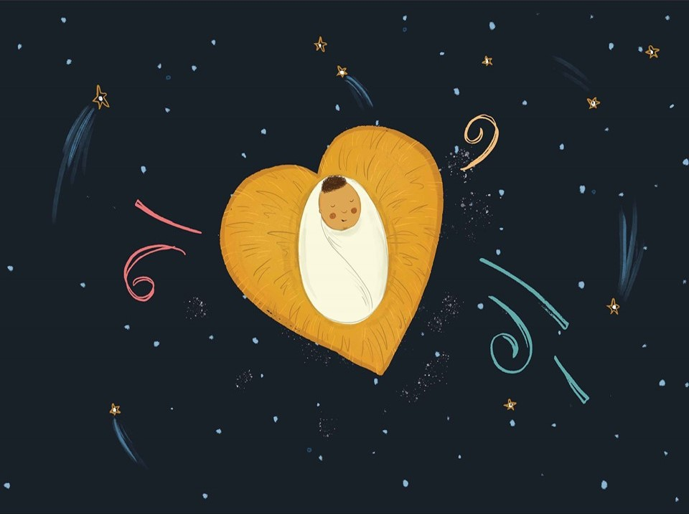

Slide 32
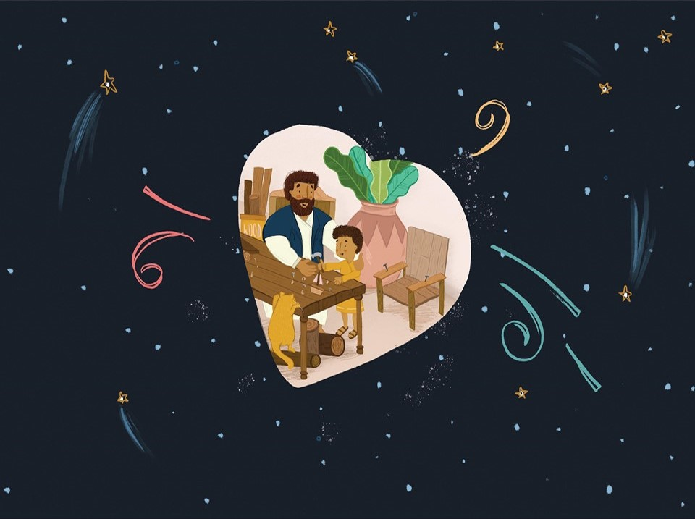

Slide 33
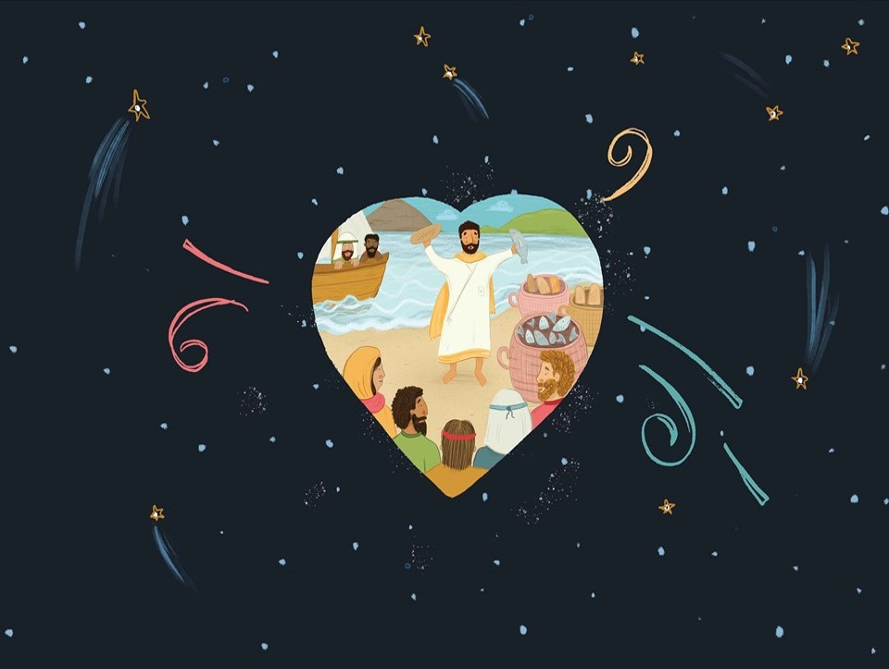

Slide 34
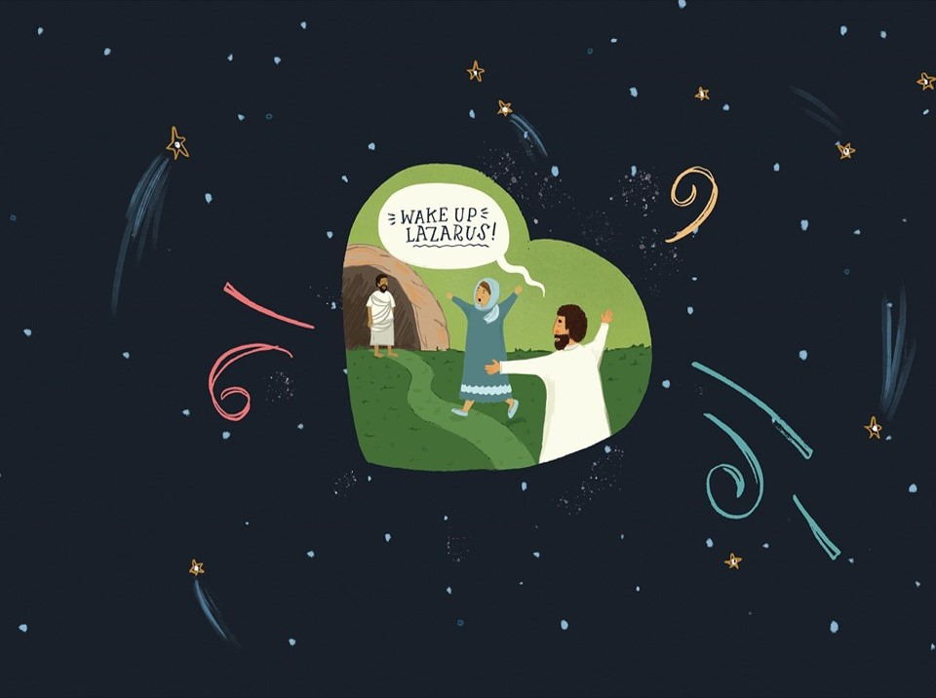

Slide 35
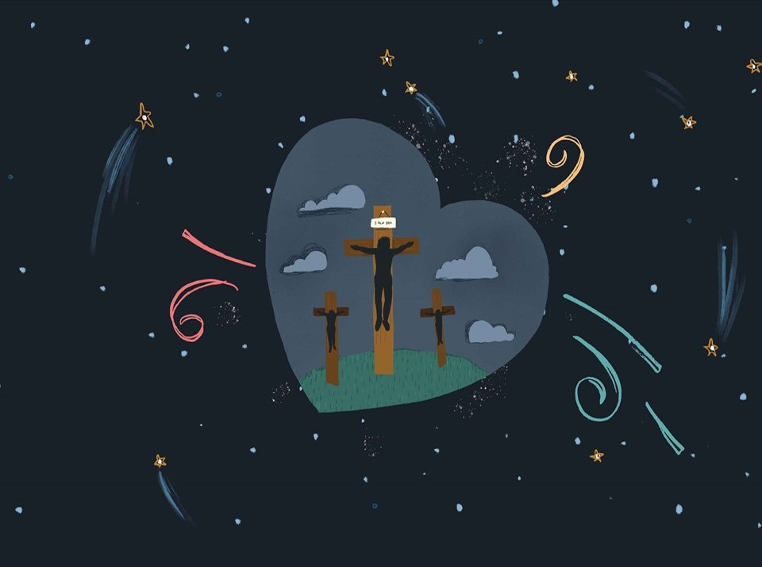

Slide 36
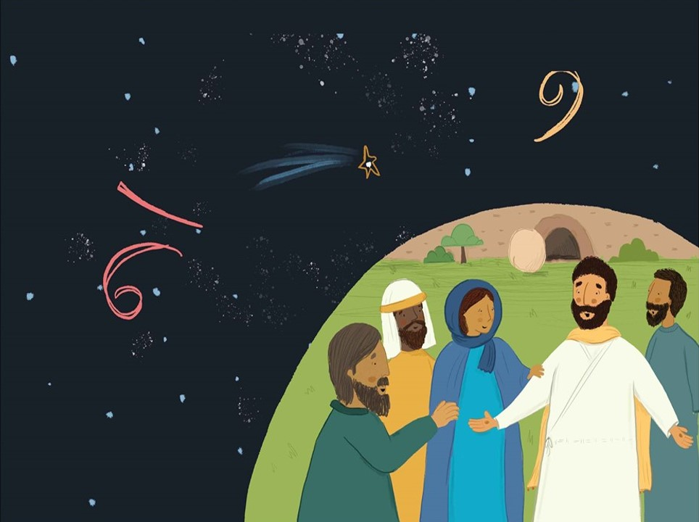

Slide 37
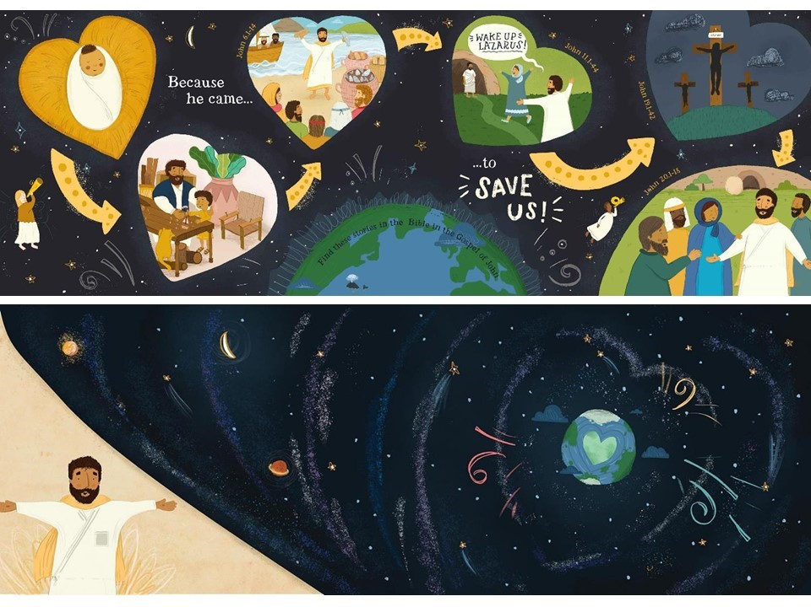

Slide 38


