Slide 3
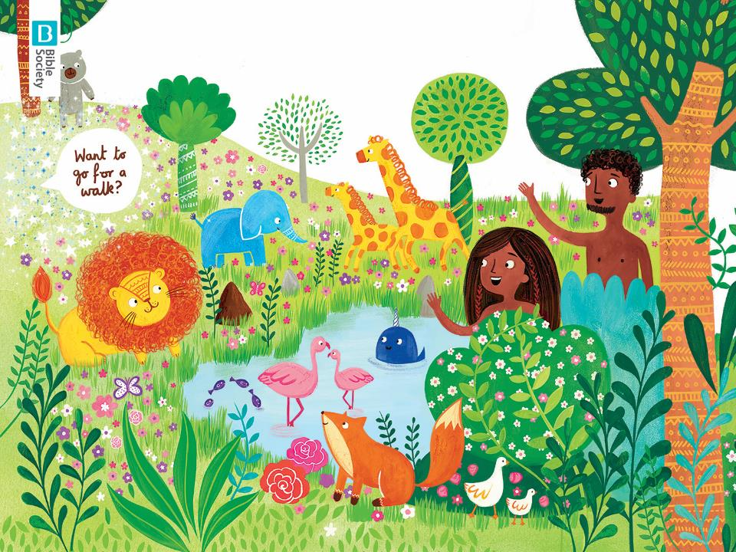

Slide 5
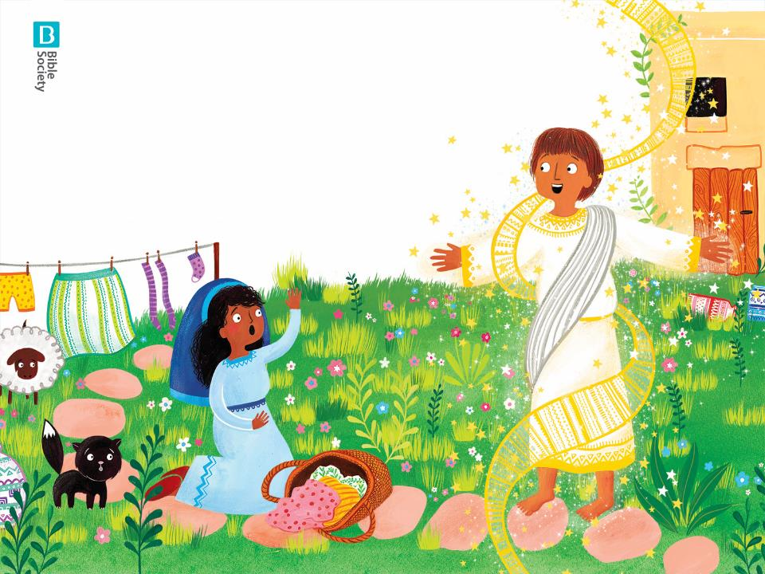

Slide 6
I bring good news
It’s well good – honest!
There’ll be a baby born
Just as God promised

Slide 7
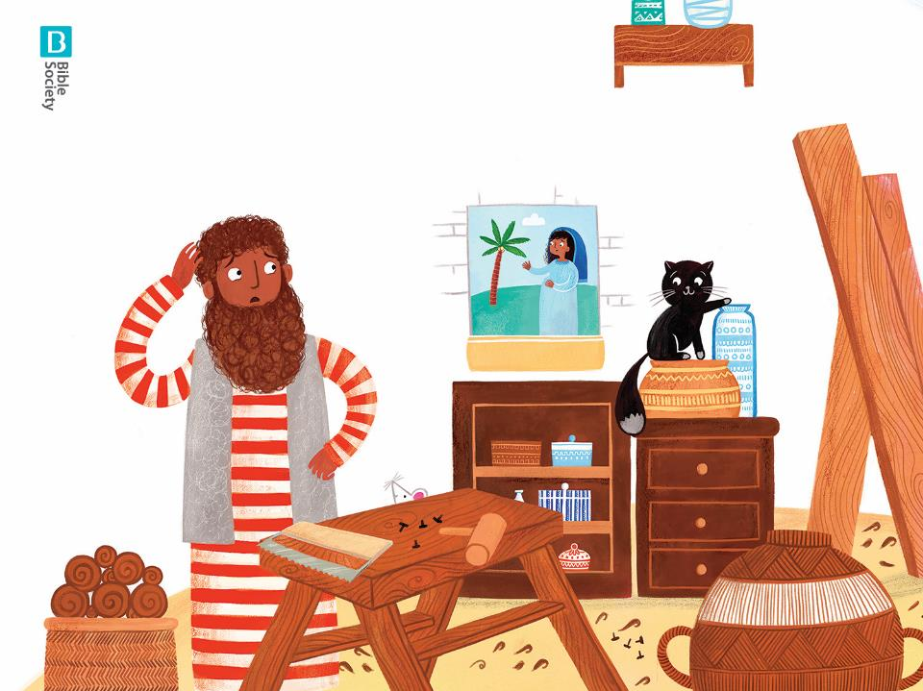

Slide 8
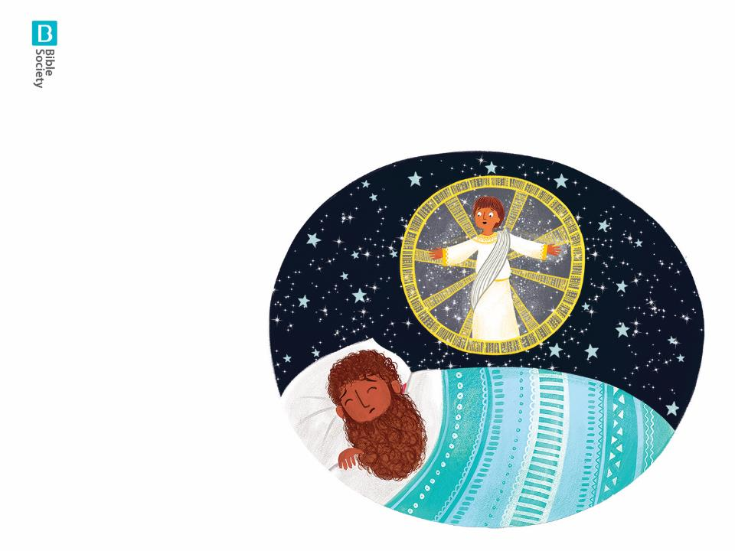

Slide 9
I bring good news
It’s well good – honest
There’ll be a baby born
Just as God promised

Slide 10
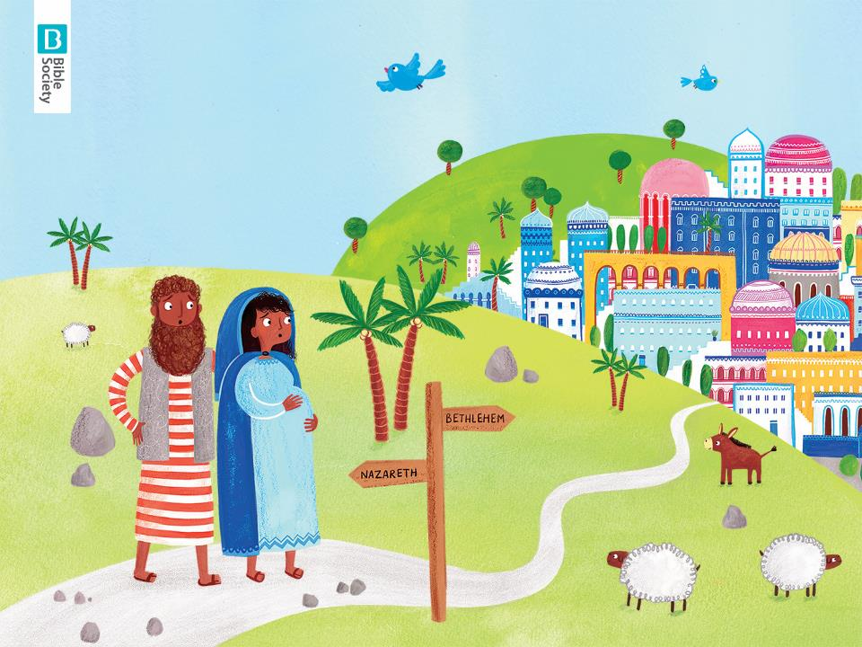

Slide 11
Don’t be afraid
Don’t get uptight
Relax, take a breather
You’ll be all right!

Slide 12
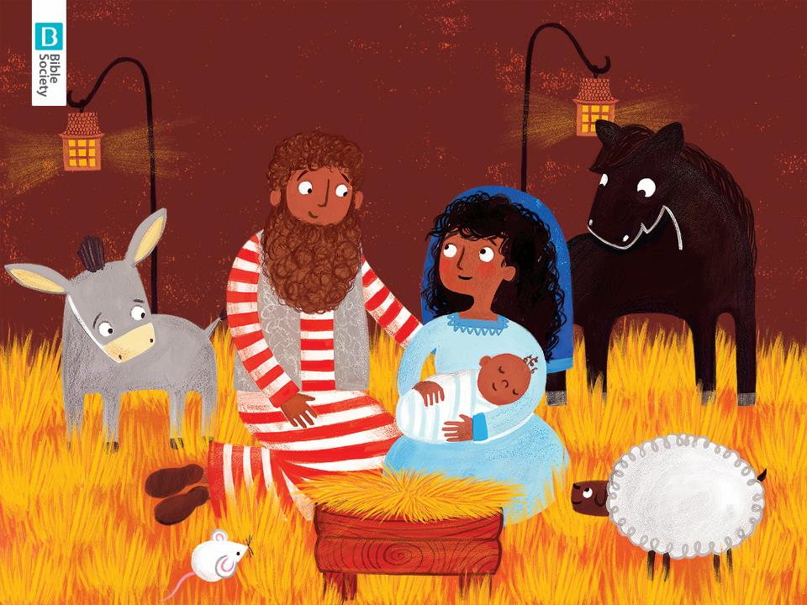

Slide 13
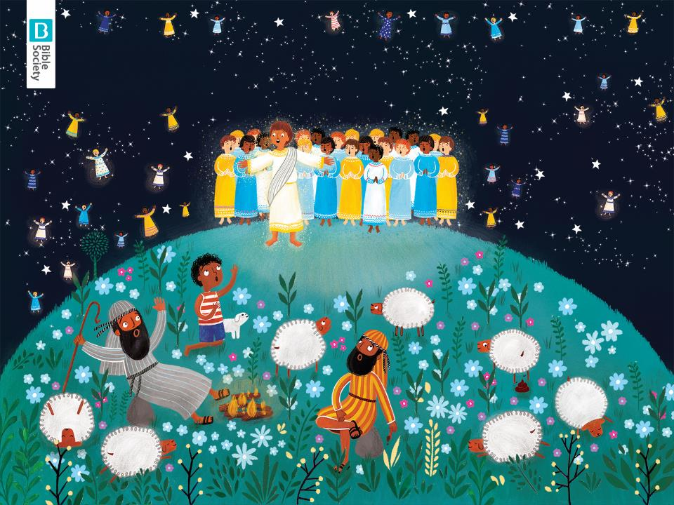

Slide 14
Don’t be afraid, That’s what I say
Say Hi to the Baby, In a manger full of hay

Slide 16
We bring good news, they said, It’s well good – honest!
There’ll be a baby born, Just as God promised

Slide 17
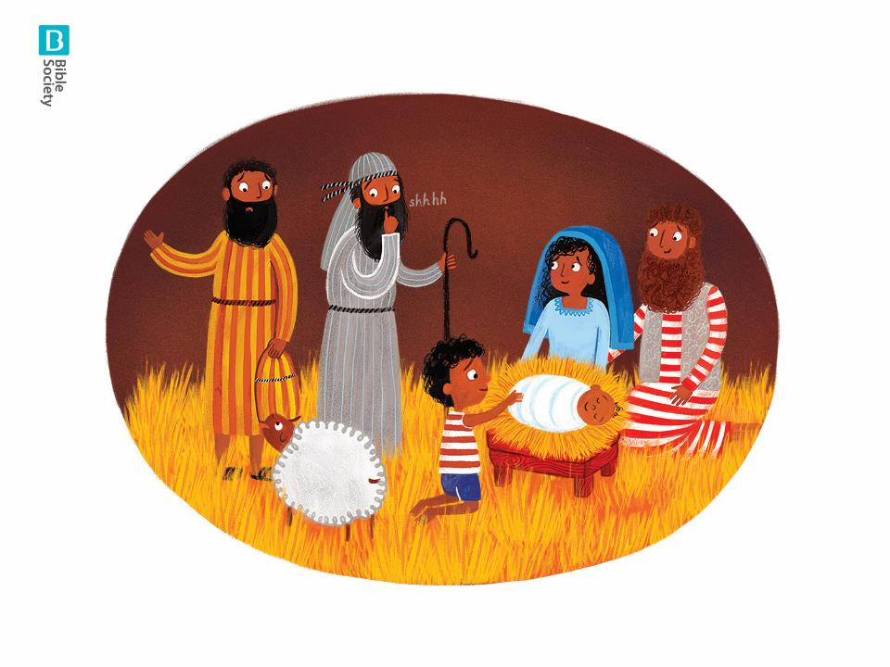

Slide 18
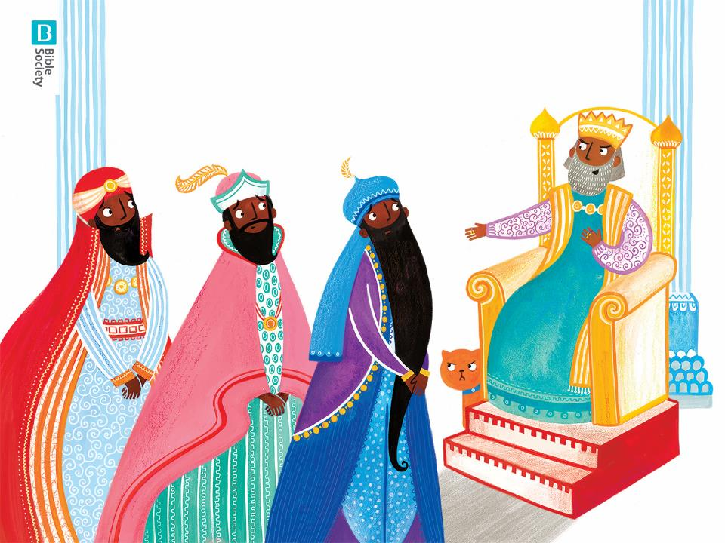

Slide 19
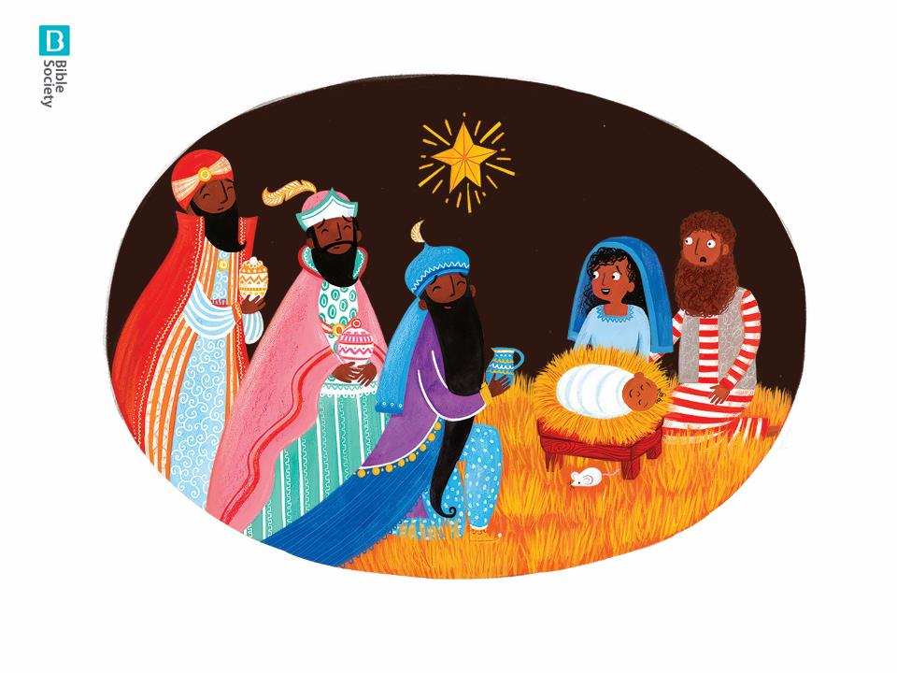

Slide 21
Don’t be afraid
Hear what I say!
Just don’t visit Herod
Go home another way

Slide 22
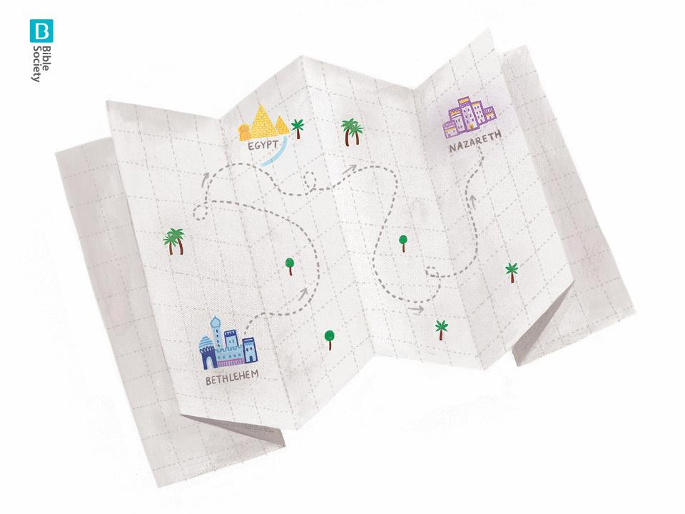

Slide 24
Don’t be afraid
Don’t get uptight
Relax, take a breather
You’ll be alright!

Slide 25
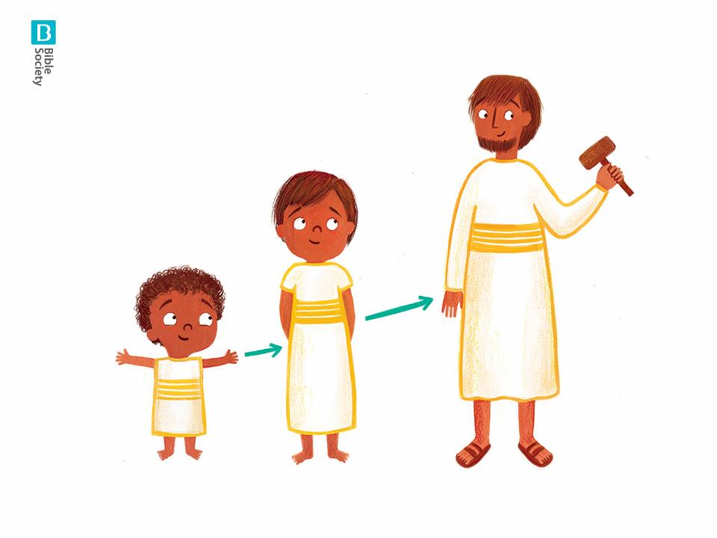

Slide 26
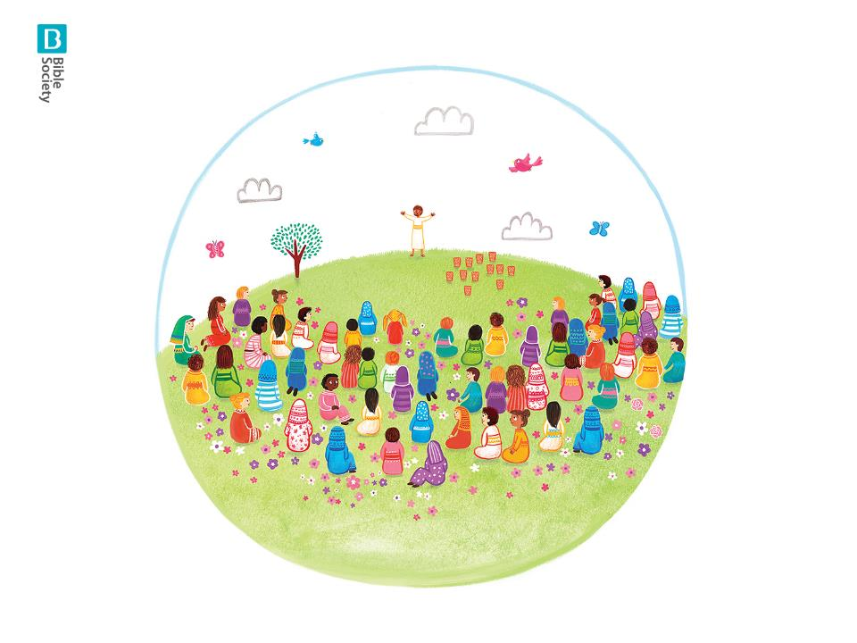

Slide 28
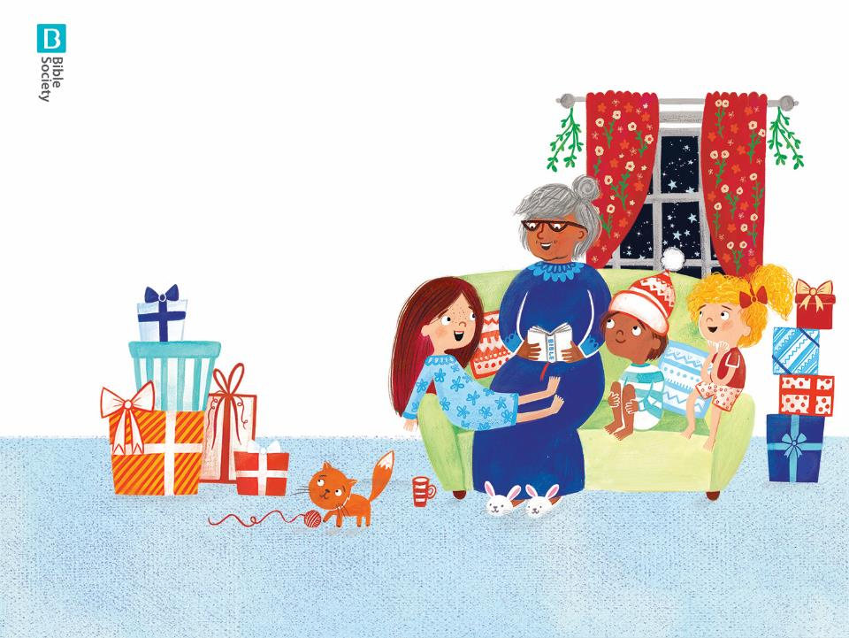
So don’t get scared, or jumpy
And don’t be afraid
”I will be with you always”
– says Jesus
“Not for a bit, but always”

