Slide 1
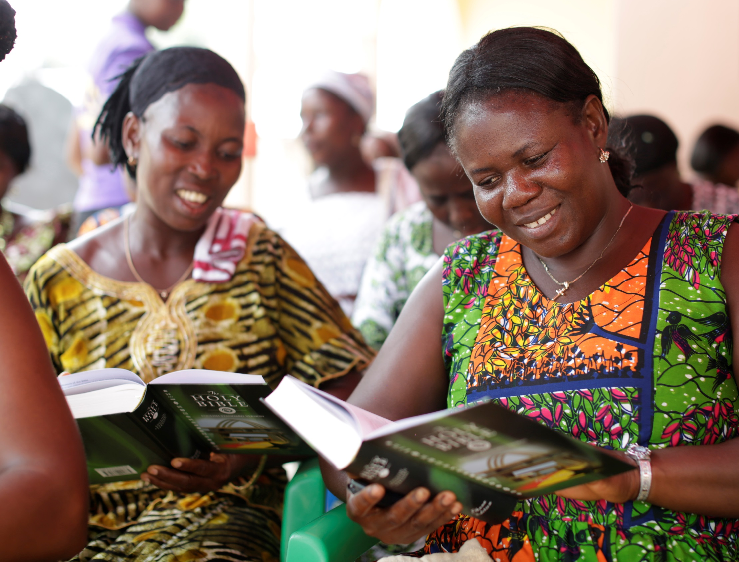
Bringing the Bible to Life
In Africa
Photography by Layton Thompson

Slide 2
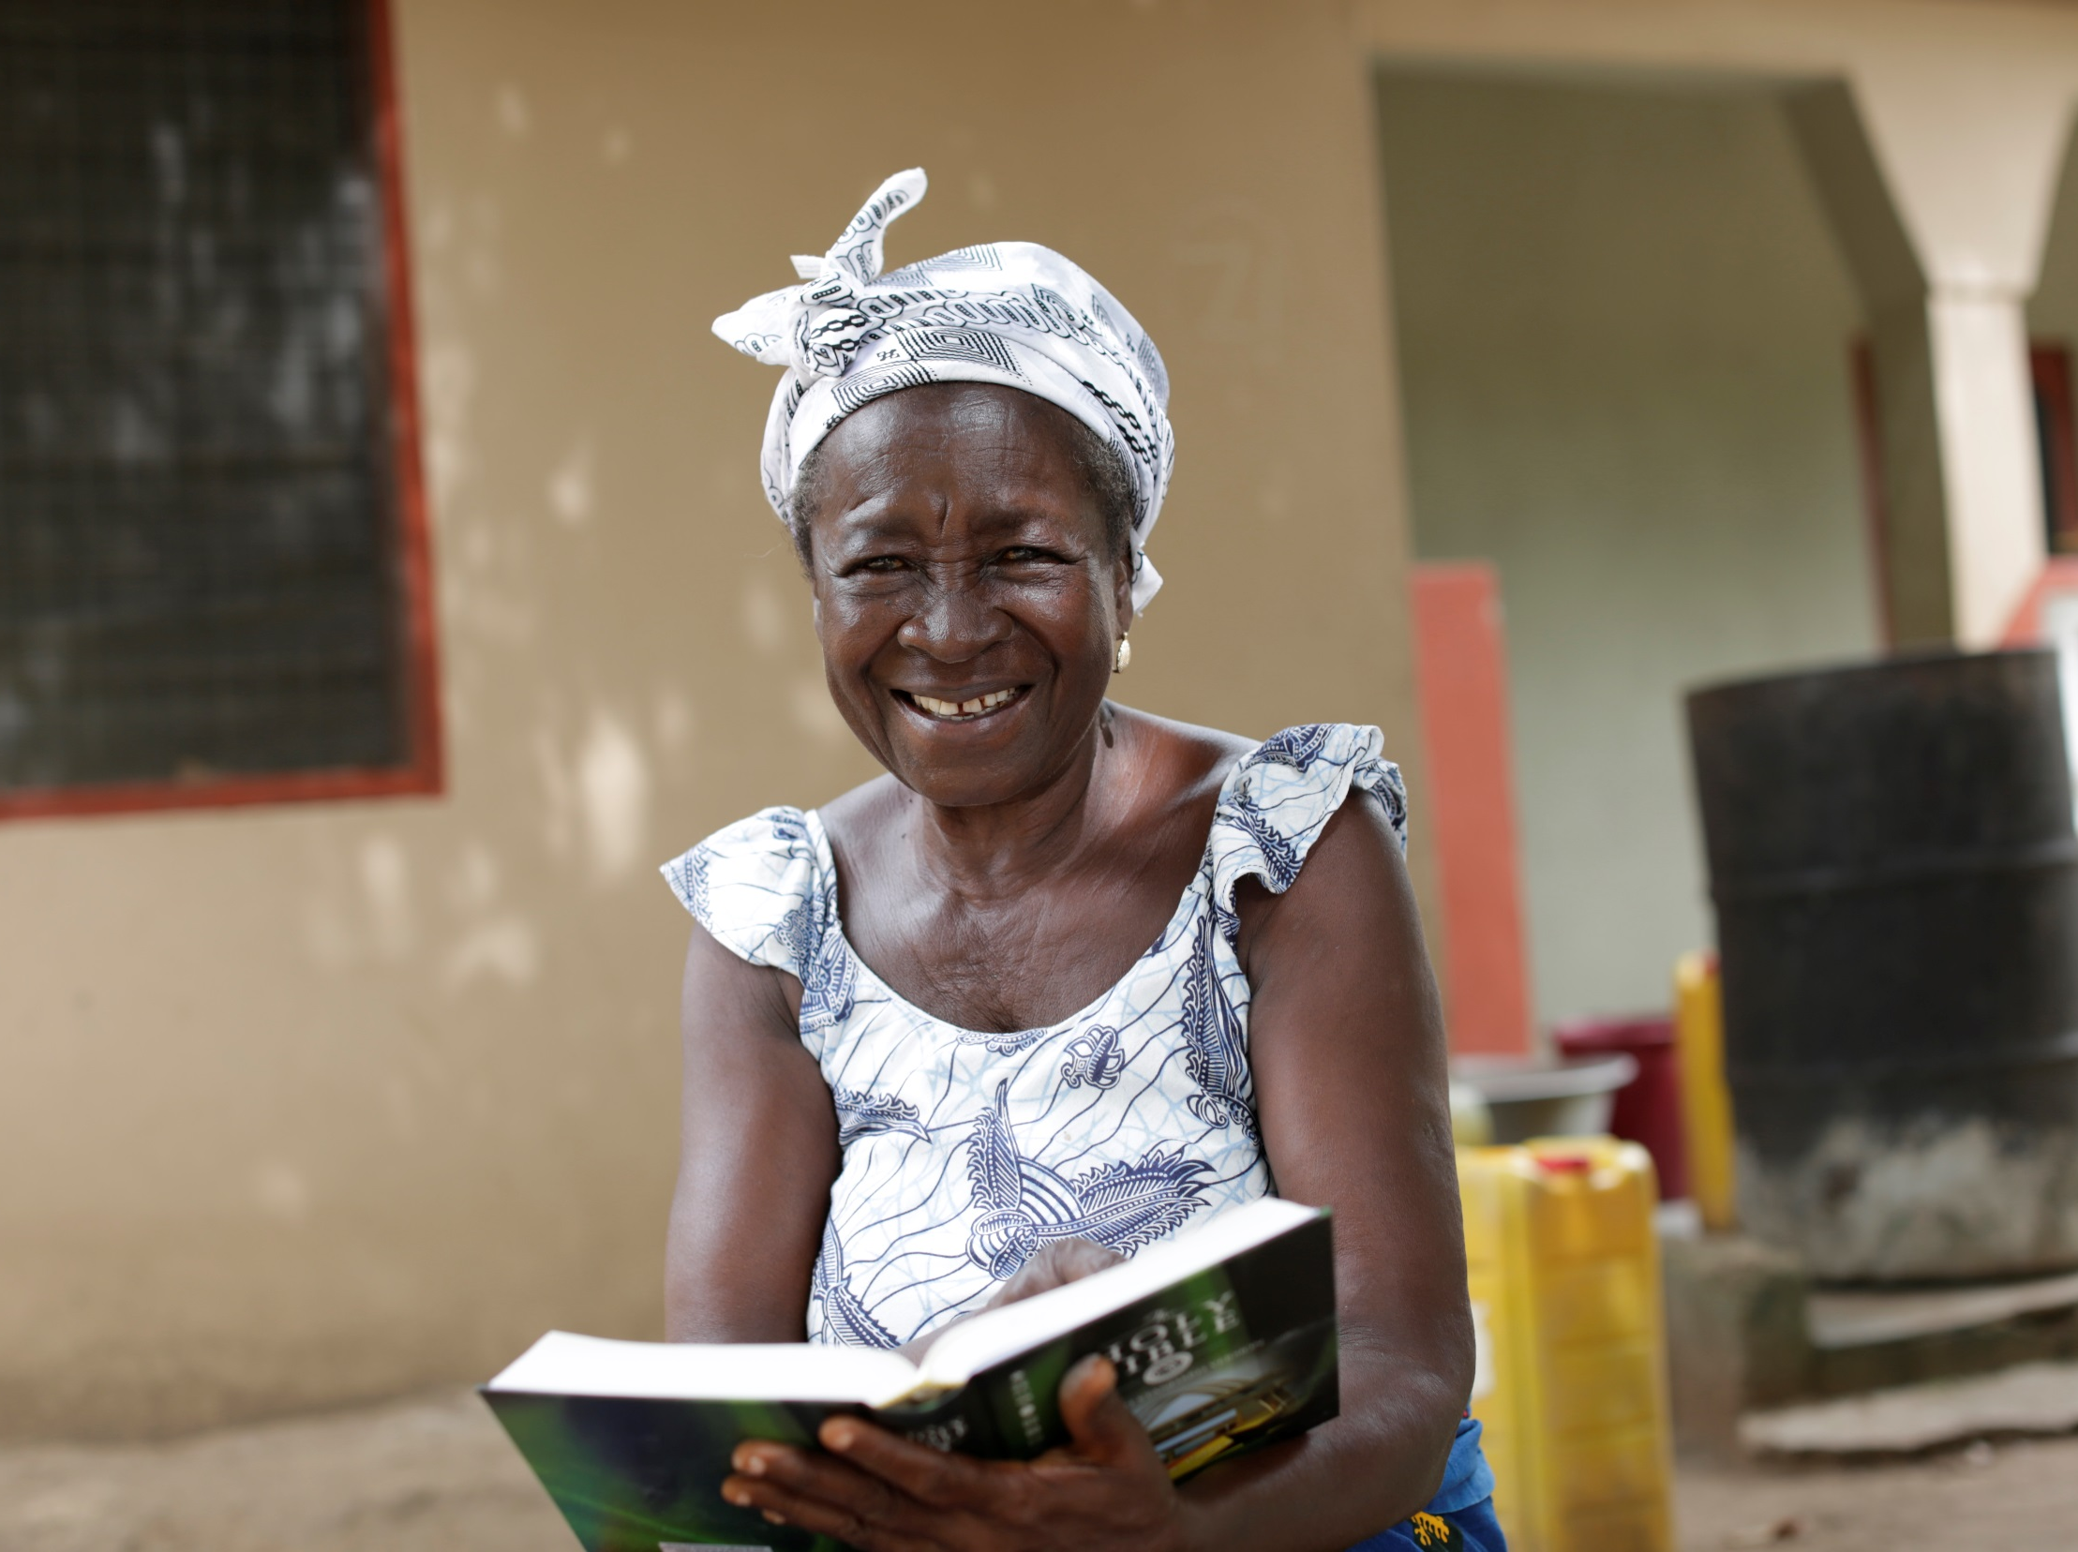
Photography by Layton Thompson
Notes:
‘If I don’t have a Bible, how can I know God? Because the word of the Bible is the word of God.’ – Elizabeth, 72, in photo.

Slide 3
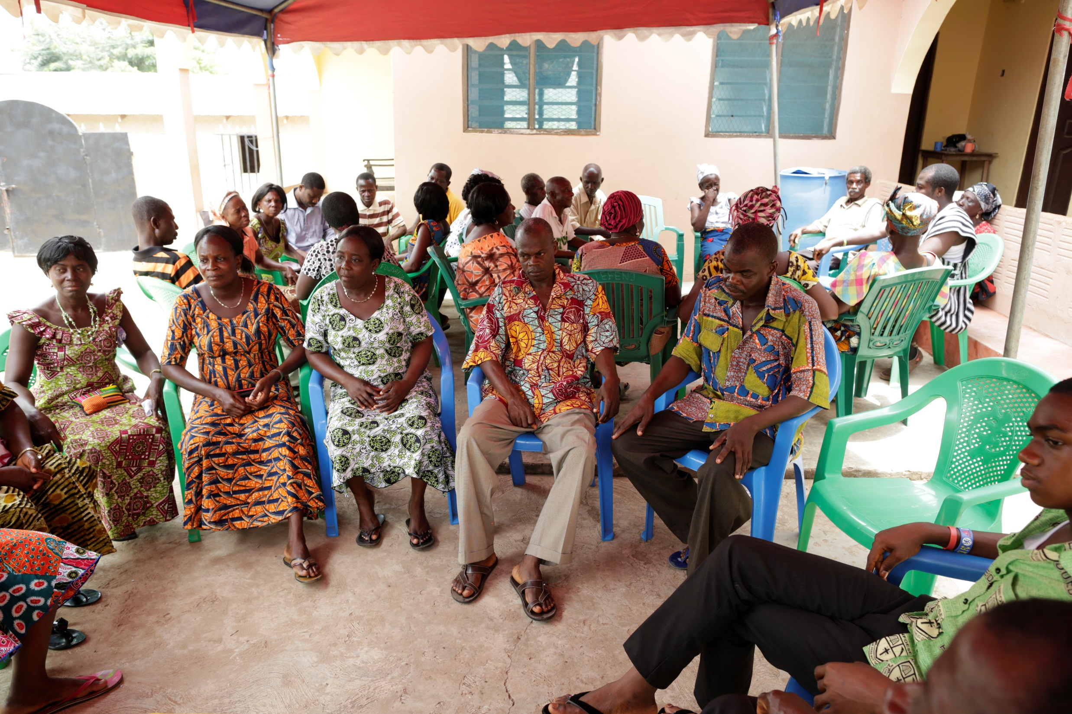
Photography by Layton Thompson
Notes:
Each week, 30 people complete an Alpha course in Ghana – and they need a Bible to sustain what they learn.

Slide 4
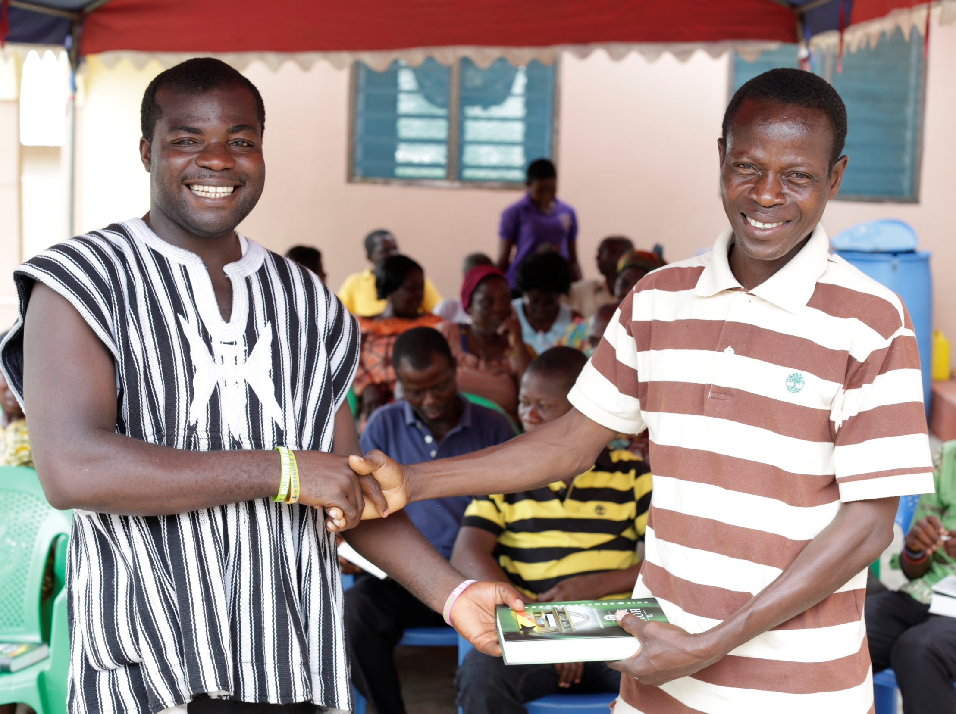
Photography by Layton Thompson
Notes:
As most Alpha participants are either prisoners, students or those from poor rural areas of the country, our priority is to provide a free copy of Scriptures for each one of them.

Slide 5
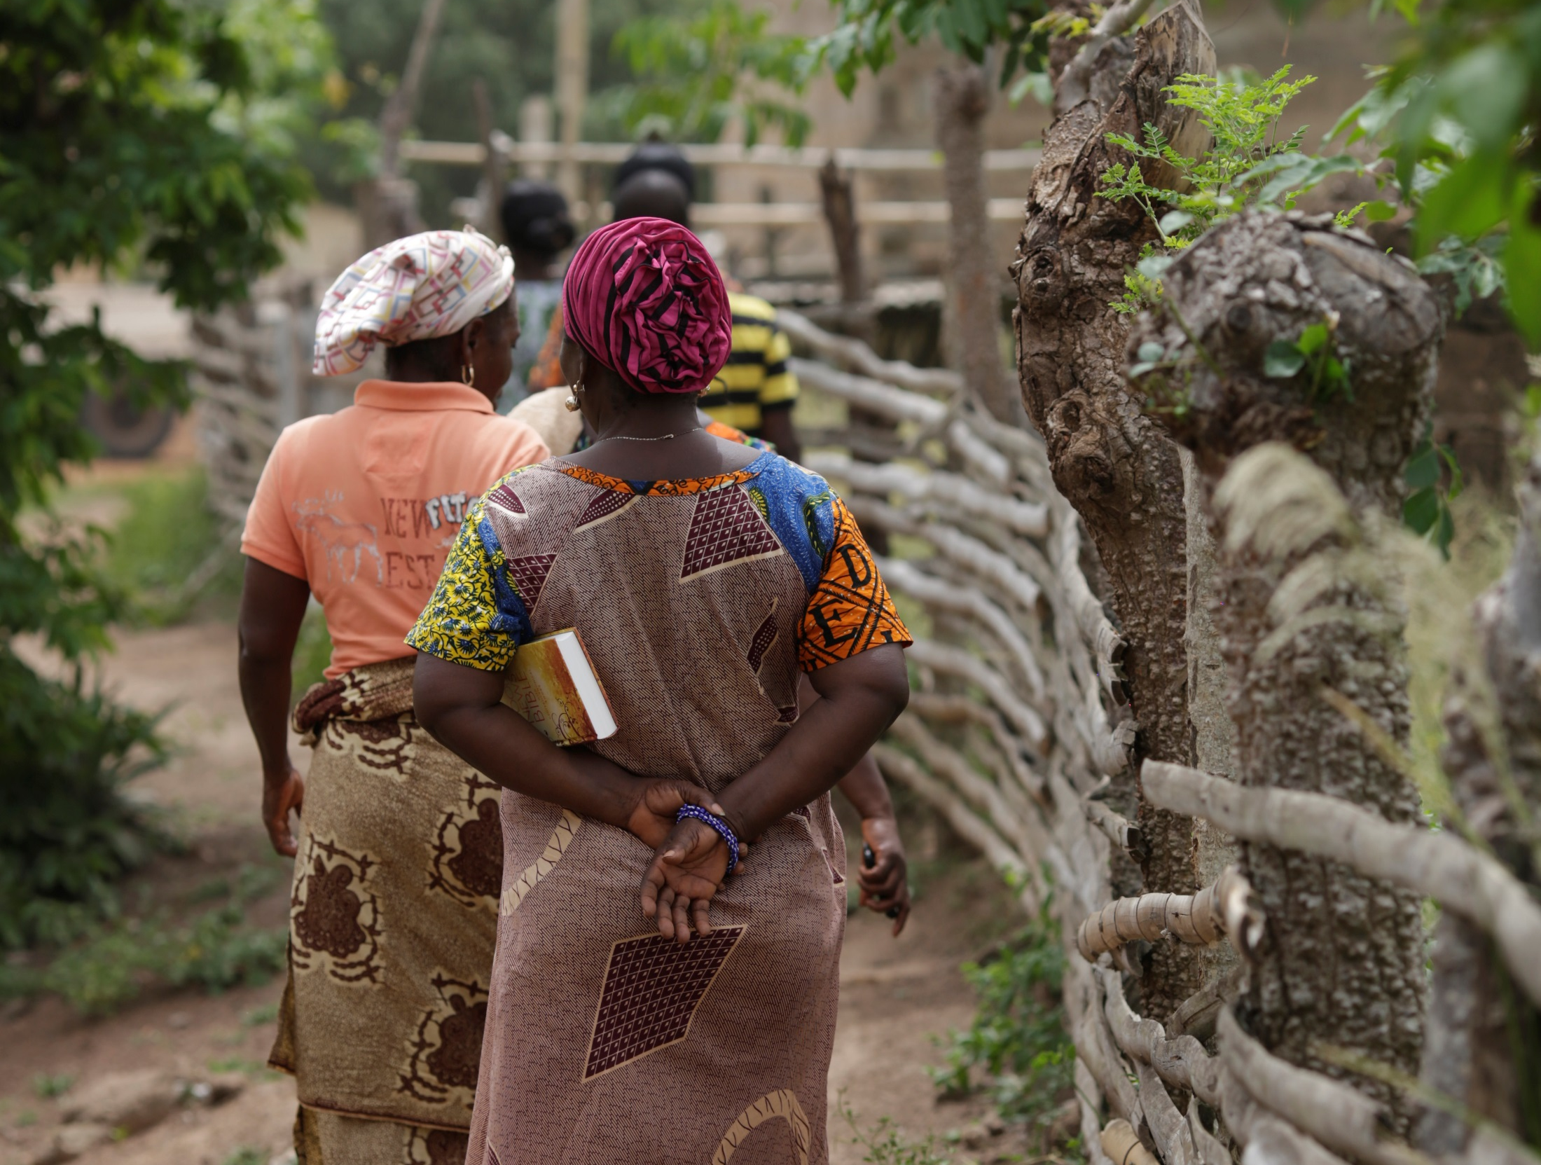
Photography by Layton Thompson
Notes:
Because:
1. For those living in rural villages, the Bible is a luxury they cannot afford. Many rural families are subsistence farmers, so have little money to spare.

Slide 6
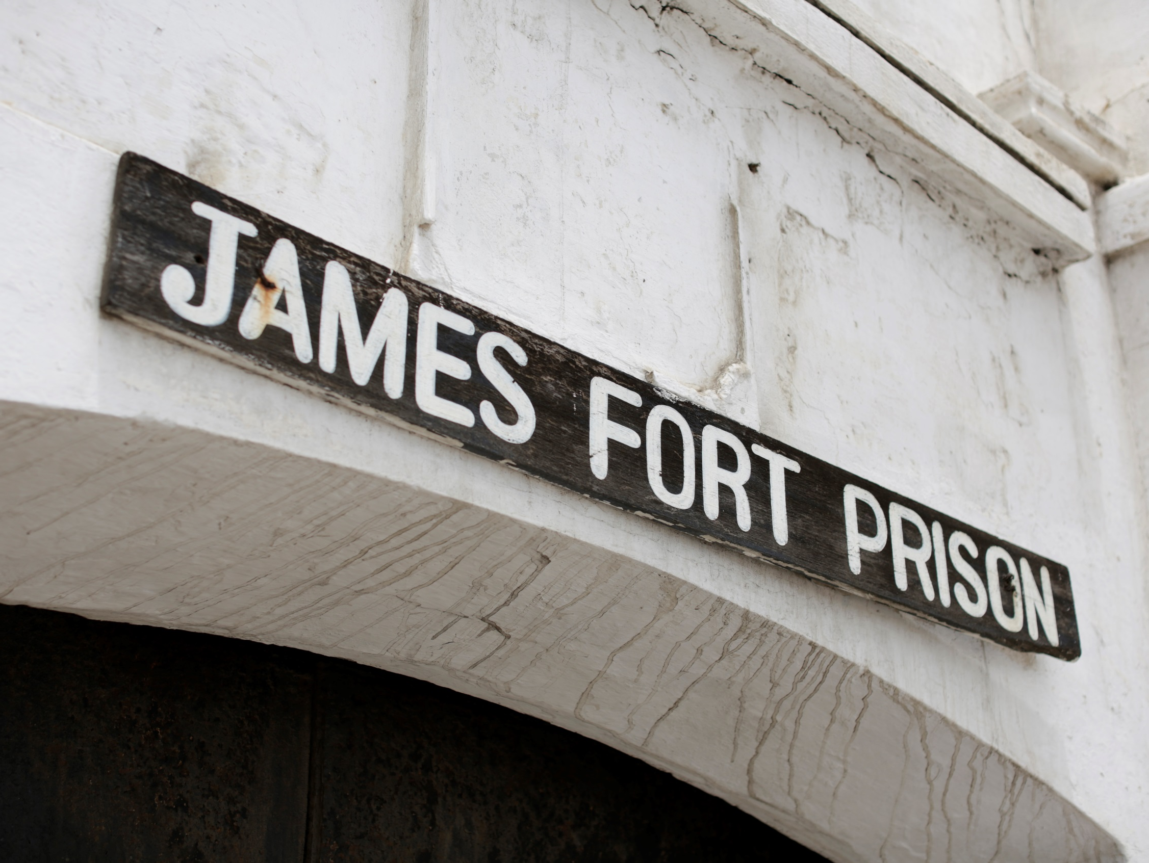
Photography by Layton Thompson
Notes:
Because:
2. Prisoners are unable to buy copies of Scripture, even if they had the funds. It’s vital that we provide Bibles to inmates who have time and motivation to read Scripture and reflect on their lives.

Slide 7
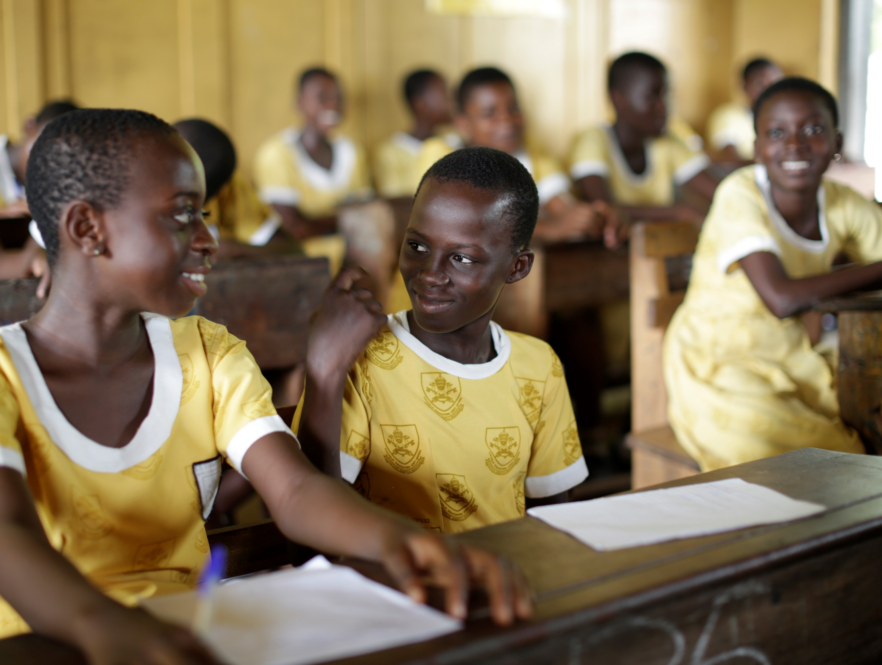
Photography by Layton Thompson
Notes:
Because:
3. It’s common for young people to use their parents’ Bible instead of having one of their own. Every year, our Ghana office receives hundreds of letters from students asking for a Bible.

Slide 8
Pray for our work
Notes:
Please pray for Africa.
Give thanks for the countless lives that have been changed for good through the Bible across Africa already.
Praise God that in the middle of tough situations our teams in African nations are still able to continue offering the Bible to those around them.
Pray with us that as African Bible Societies work hard to offer the Bible, the value of God’s word would become clearer and clearer.
Please pray for the General Secretaries who lead the follow Bible Societies with whom we have a close relationship.
Clapperton Mayuni and his team in Malawi,
Mbuli Ngcebo and his team in Swazliand,
Edward Kajivora and his team in South Sudan
Erasmus Nii Bonne Odonkor and his team in Ghana
Thank you for standing with us in prayer.

Slide 9
With your help,
we can put a Bible
into their hands –
a Bible that can change
lives, for good.

Slide 10
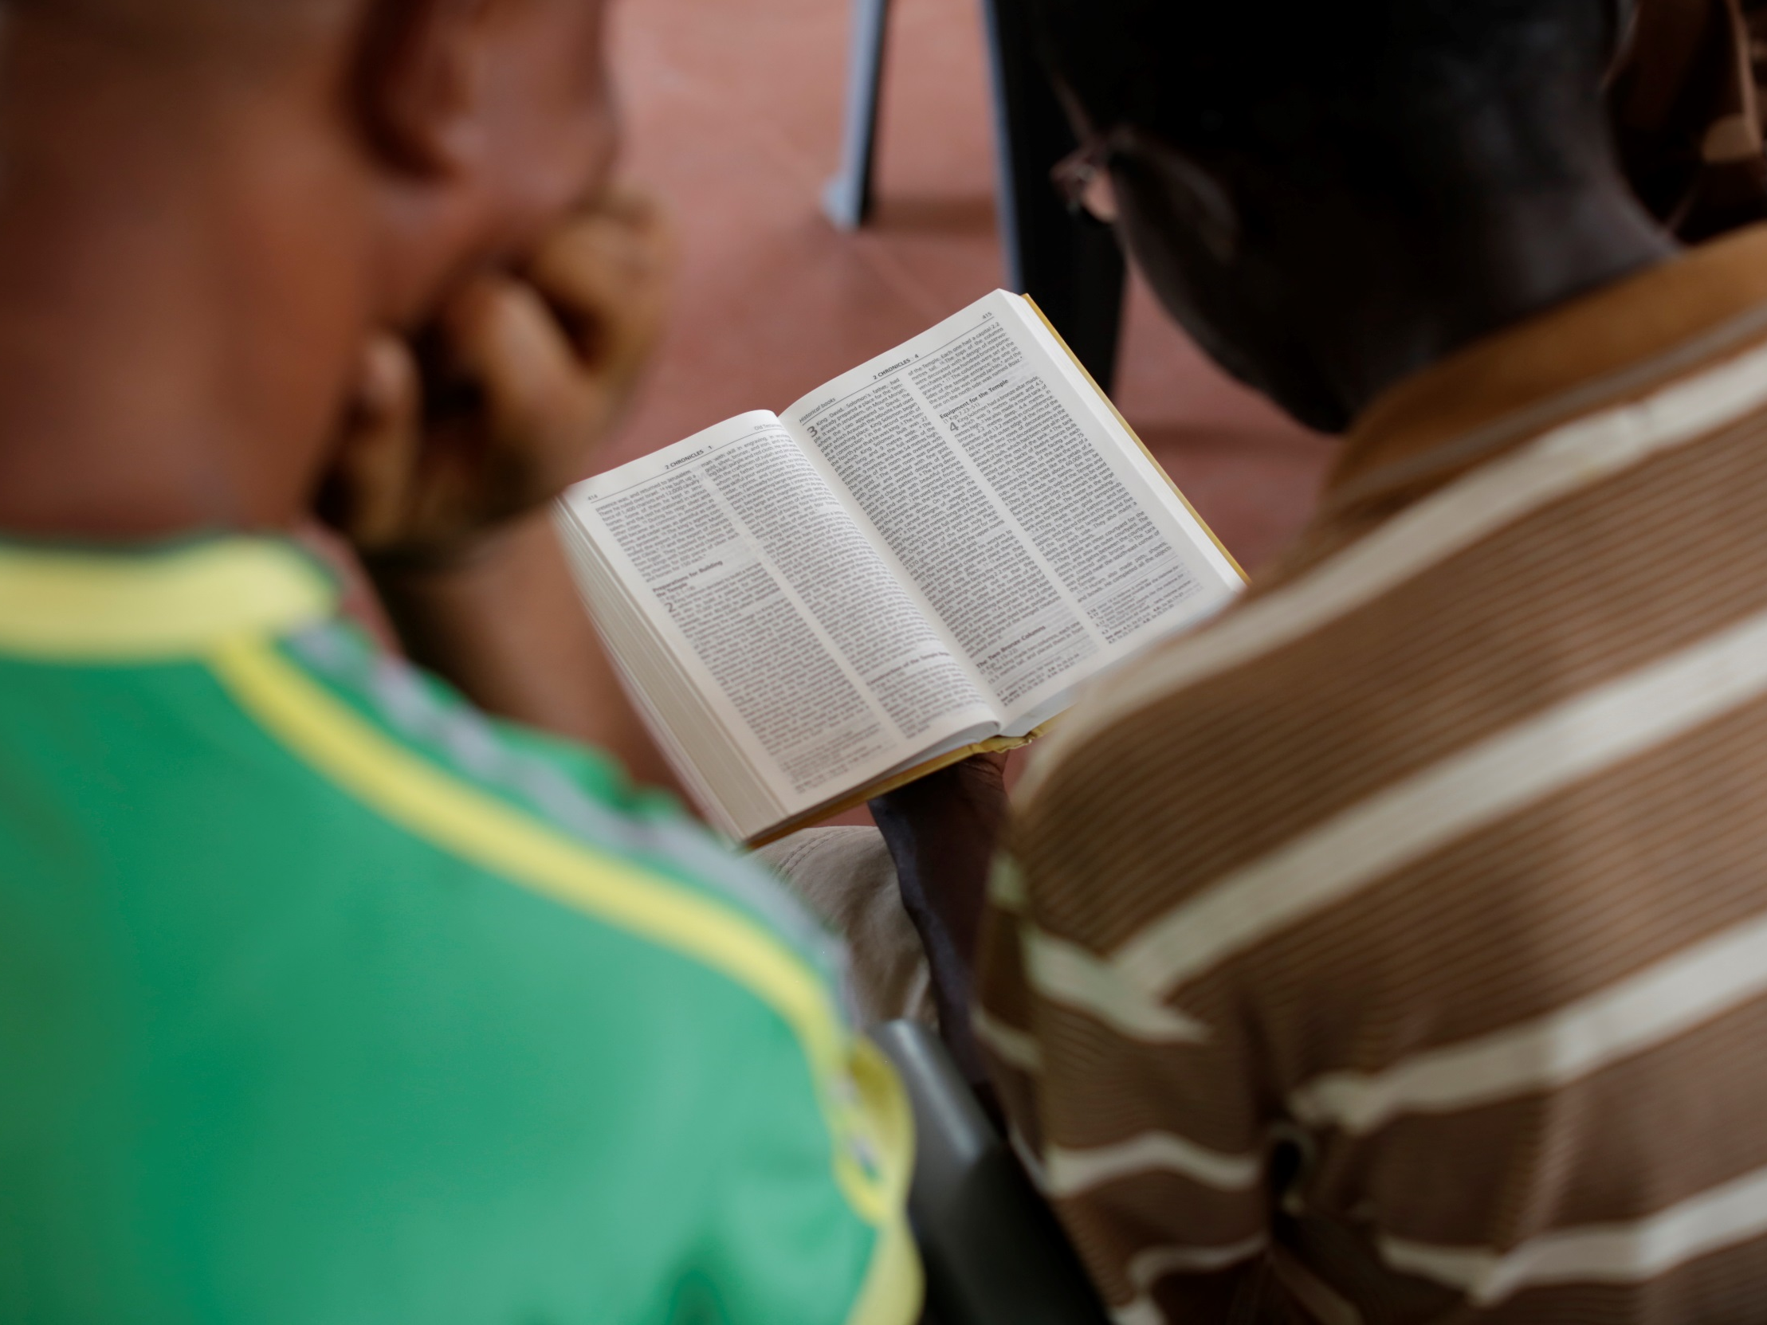
Thank you for your support
Photography by Layton Thompson
biblesociety.org.uk

